Slide 1
Beyond Consent Workshops
An Introduction to Structural Sexual Violence Prevention for Cooperative Members

Slide 2
Overview
Introductions
Discussion: Unpacking Consent
4 Pillars of Sexual Violence Prevention
Public Health Concepts: Risk/Protective Factors & the SEM
Activity: Reimagining Sexual Violence Prevention
Outros

Slide 3
Big Ol’ Trigger Warning
This session is going to involve really explicit discussion of sexual violence, and may also include discussions of homophobia, misogyny, transphobia, racism, ableism, and other systems of structural violence and oppression.
If at any point, you would like to step out and take a breather, that is 110% okay. I am also trained to work with survivors in crisis and more generally, and am happy to debrief with you after the workshop, if you’d like.

Slide 4
Ground Rules
One Diva, One Mic (aka Uninterrupted Time Is Sacred And I Might Kick You Out If You Interrupt People)
Move Up, Move Up (especially in your small groups, where I can’t vibe check the dynamics as easily)
Be Aware Of Time (especially as it relates to equitable sharing)
Be Curious (especially if someone says something you don’t understand, don’t agree with, or think is totally messed up)
Adapted from AORTA’s Anti-Oppressive Facilitation Resource Sheet, 2014

Slide 5
Who Am I...
Evelyn Smith, Community Outreach Coordinator - Middle Way House, Inc.
She/her/hers or they/them/theirs
Fat trans lesbian & sexual violence survivor
Angry feminist
Bachelors’ in Biology and Gender Studies
Currently working on a Master’s of Public Affairs
Activist & sexual violence preventionist

Slide 6
...Who Are You...
Names
Pronouns
What do you do?
What kinds of connections do you have in your community?
And depending on group size:
What are you hoping to get out of this workshop?

Slide 7
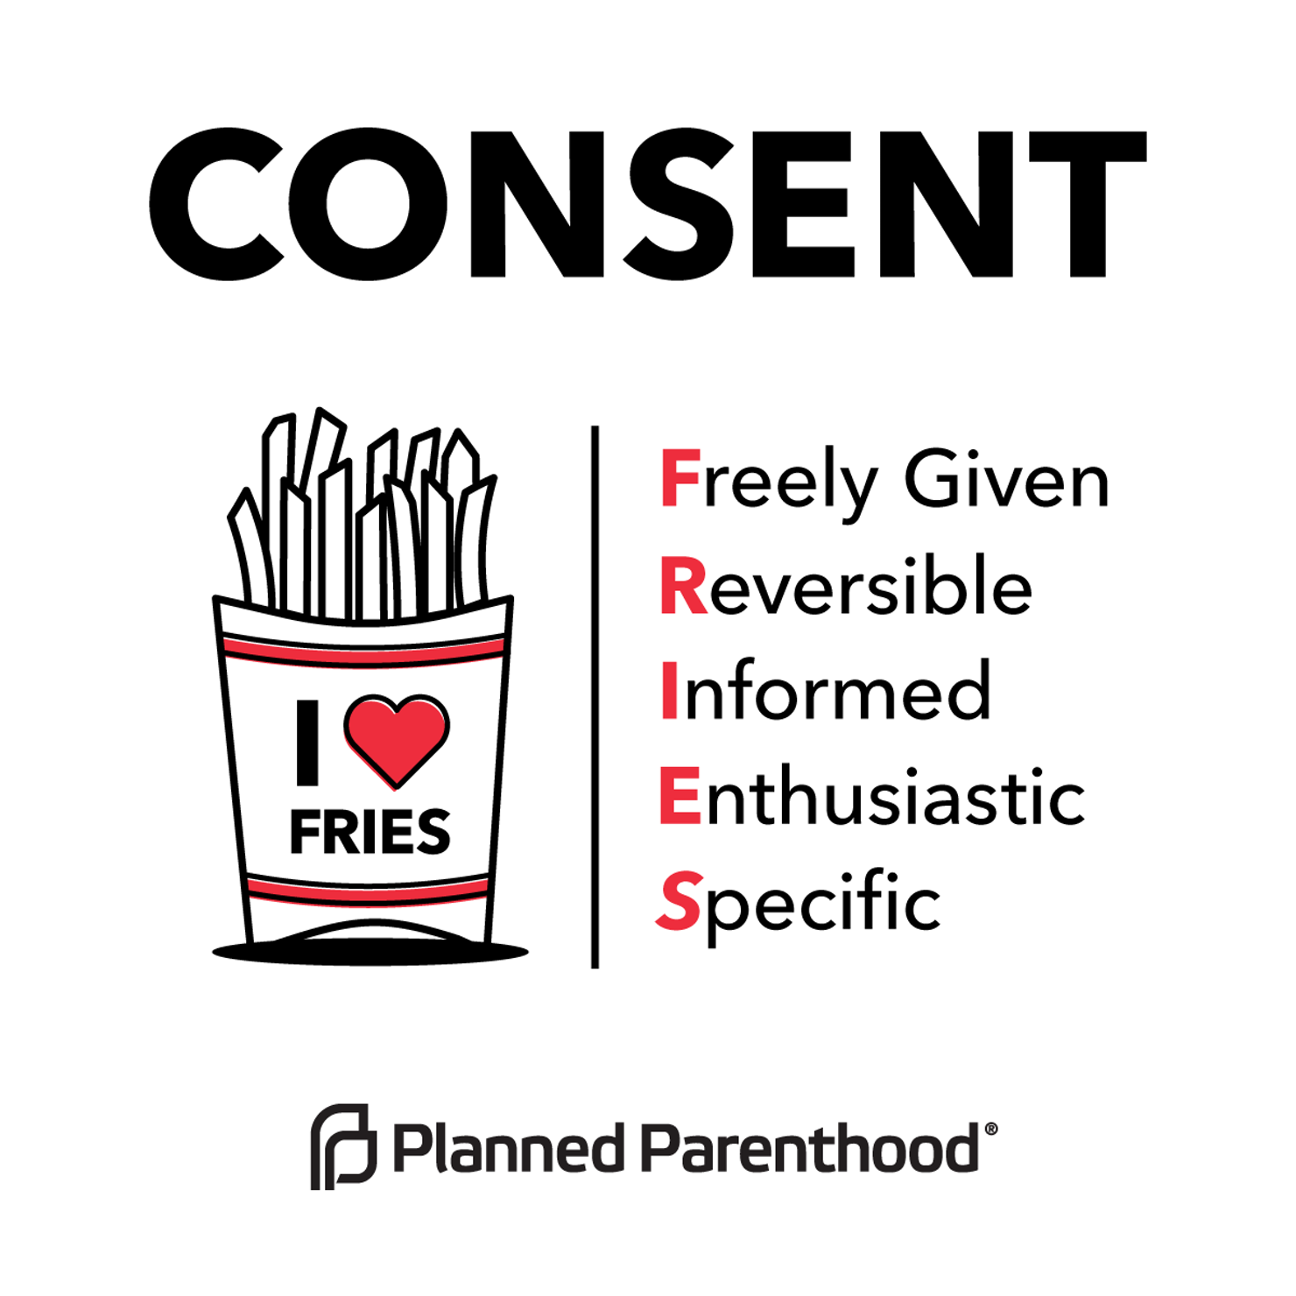
A Brief Aside: What Is Consent?
Freely Given: not coerced; no pressure, force, violence, or threat of violence
Reversible: can be revoked at any time
Informed: aware of all relevant risks and information, and sober/clear-headed enough to consider them
Enthusiastic: “well, okay” or “I guess, if you want to…” or “I don’t wanna disappoint you” all mean “no”!
Specific: consent applies to a specific act at a specific time only--it doesn’t “carry over”
Notes:
This is not a consent workshop, but you need to know what we’re talking about when we talk about consent. This is the framework we use when teaching young people how to practice it--it may not look like yours, but there’s probably a lot of overlap.

Slide 8
...And What Is The Problem With Teaching Consent?
Believe it or not, we’re actually pretty big fans of consent--but obviously we’re not convinced it’s enough to solve the problem of sexual violence.
What do you think? Are consent workshops effective strategies for ending sexual violence?
Why or why not?
Notes:
Telling people to use consent workshops as a core prevention strategy is like telling people to recycle to end global warming (!)

Slide 9
...And What Is The Problem With Teaching Consent?
What problems does teaching consent solve?
Is that effective? Why?
Are there problems that teaching consent doesn’t solve?
Notes:
Telling people to use consent workshops as a core prevention strategy is like telling people to recycle to end global warming (!)

Slide 10
Notes:
Power, Control, and Intimate Partner Sexual Violence in Haiti Anastasia J. Gage, Ph.D.1,2 and Paul L. Hutchinson, Ph.D.1
http://www.consented.ca/basics/power-and-control/
http://www.who.int/violence_injury_prevention/resources/publications/en/guidelines_chap2.pdf

Slide 11
Ending sexual violence demands a multi-pronged approach...

Slide 12
(My) Four Pillars of Sexual Violence Prevention
If all people have the resources needed to live healthily, happily, and independently...
If nobody has the structural power to abuse others...
...then we will live in a world free of sexual violence and relationship violence.
If all people have the knowledge they need to build healthy, equitable, mutually sustaining relationships...
If our culture values and supports the creation of healthy, safe, equal relationships...

Slide 13
Expanding the Framework
Preventing sexual violence and relationship violence means addressing...
Knowledge
Comprehensive sex ed & consent education (Degue et al 2014)
Curricula that adequately represent and address diverse needs and norms across different communities
Resources
Meeting life-sustaining needs for all people (housing, food, medical/mental health care) (PCAR 2007)
Building social support networks & social capital; Access to social structures (schools, churches, etc.) (ICRW 2000)
Culture
Positive depictions of healthy, equal relationships; negative depiction of unhealthy/unequal relationships; Culture that humanizes marginalized people (women, people of color, queer & trans folks, homeless folks, sex workers, etc.) (Malamuth 1985; Opportunity Agenda 2011; CDC 2014)
Power
Changing/deconstructing violent structures of power (misogyny, racism, homophobia, transphobia, ableism, etc.) (West & Johnson 2013; NCTE 2015; CDC 2014)
Strategies to mitigate interpersonal differences in power (CDC 2014)

Slide 14
Identifying the Target Audience
Who is our programming trying to reach?
Who is it actually reaching?

Slide 15
In order to effectively address the issue of sexual violence in our communities, we’re going to have to...

Slide 16
...be comfortable resisting the temptation to dehumanize perpetrators. They are people, not monsters, and holding both them and our communities responsible requires recognizing this.
...acknowledge that rapists and abusers come from our community. They are not outsiders--they are our friends, acquaintances, the hosts of our parties, etc. etc.
...accept that our community produces rapists and abusers not by accident, but through a variety of social processes that we built--and that we can destroy.
...be okay with doing a lot of work to benefit people who would otherwise be doing really shitty things.
Notes:
Point 2: change to more specifically address the construction of people as monsters; humanization/dehumanization dichotomy? Present as barrier to effectively creating change.
Contrast w/: Who is the audience of consent workshops?
Rapists and abusers! Rapists and abusers cause sexual violence!
Slide Content:
Who is responsible for rape and sexual violence?
In order to effectively address the issue of sexual violence in our communities, we’re going to have to…
...acknowledge that rapists and abusers come from our community. They are not outsiders--they are our friends, acquaintances, the hosts of our parties, etc. etc.
...get comfortable with treating rapists and abusers like the complex, deeply flawed, but still human people that they are.
...accept that our community produces rapists and abusers not by accident, but through a variety of social processes that we built--and that we can destroy.
...be okay with doing a lot of work to benefit people who would otherwise be doing really shitty things.

Slide 17
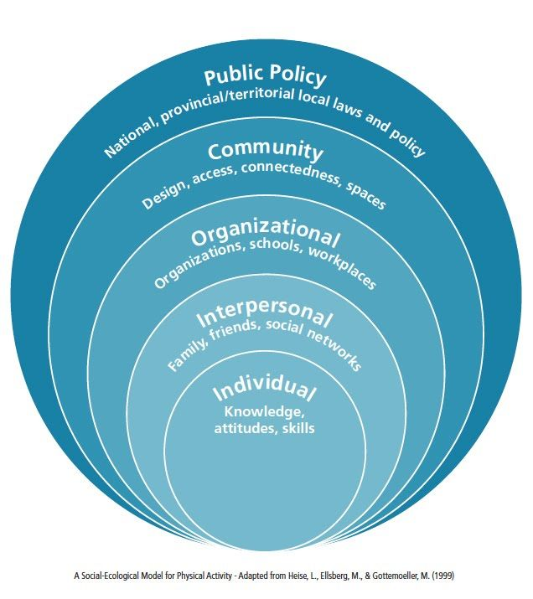
The Social-Ecological Model
Society is composed of relationships nested within one another:
Societies are made up of Communities
Communities are made up of Institutions
Institutions are made up of People
People are made up of Individuals
Individuals have complex inner lives, motivations, and needs

Slide 18
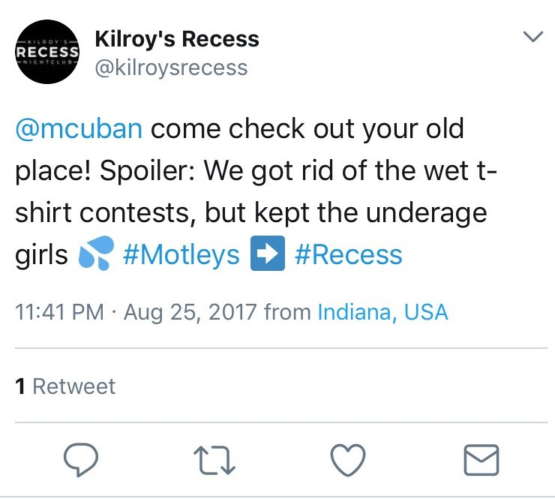
Applying SEM to Prevention

Slide 19
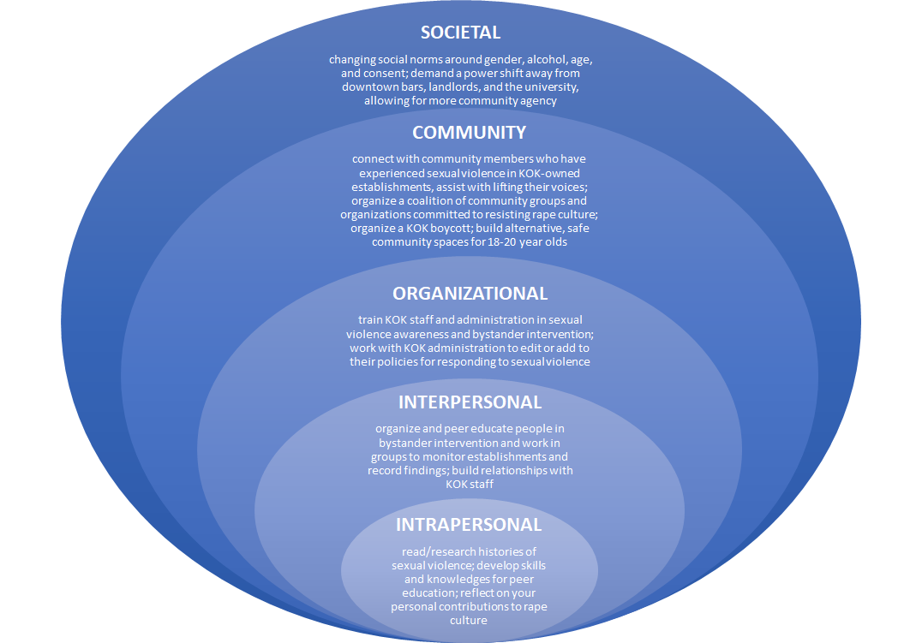
The Social Ecology of Rape Culture
•INTRAPERSONAL
read/research histories of sexual violence; develop skills and knowledges for peer education; reflect on your personal contributions to rape culture
•INTERPERSONAL
organize and peer educate people in bystander intervention and work in groups to monitor establishments and record findings; build relationships with KOK staff
•COMMUNITY
connect with community members who have experienced sexual violence in KOK-owned establishments, assist with lifting their voices; organize a coalition of community groups and organizations committed to resisting rape culture; organize a KOK boycott; build alternative, safe community spaces for 18-20 year olds
•ORGANIZATIONAL
train KOK staff and administration in sexual violence awareness and bystander intervention; work with KOK administration to edit or add to their policies for responding to sexual violence
•SOCIETAL
changing social norms around gender, alcohol, age, and consent; demand a power shift away from downtown bars, landlords, and the university, allowing for more community agency

Slide 20
Risk and Protective Factors
Protective Factor: a person, trait, relationship, skill, or resource the presence of which insulates a person from different kinds of violence
Risk Factor: a condition, whether individual or community-wide, that makes a person more vulnerable to a given kind of violence

Slide 21
Brainstorming: SV Risk and Protective Factors
Consider...
What skills might a person need to practice good consent? (Individual)
What kinds of relationships might protect someone from SV, or prevent them from perpetrating it? (Interpersonal)
What community institutions need to exist to teach skills or build the relationships above? How do existing institutions need to change? (Organizational/Community)
What social norms in our culture make sexual violence as common as it is? What norms might we replace those with to make people safer? (Society/Culture)
Split into N groups (based on group size)!
You’ll be brainstorming some risk and protective factors for sexual violence!
Notes:
Instructions on next click.
5 questions for 5 levels?
Intra: mental health
Inter: communication and skills

Slide 22
Sharing & Brief Large-Group Discussion
Was there a lot of overlap between different groups?
Are there any on here that you’re having a hard time connecting to sexual violence, or to student communities?
Are there any issues up here that seem connected?
Notes:
Needs edited, yea?

Slide 23
Some Known & Documented Risk and Protective Factors
Risk Factors
Lack of nonviolent social problem-solving skills
Conflict within families/Poor parent-child relationships
Neighborhood poverty
Harmful norms around masculinity & femininity
Protective Factors
Social connectedness to the community and neighborhood
Connection and commitment to school (& other institutions)
Access to mental health and substance dependency treatment services (note: documented for IPV)
Data from CDC, Connecting the Dots, 2014

Slide 24
A Very Brief Note on Perpetration vs. Victimization
Many of the risk and protective factors for sexual violence are shared between perpetrators and survivors.
Some shared factors:
past experiences of victimization
poverty & economic (in)stability
education about sexual violence
addiction/substance use
Data from CDC, Connecting the Dots, 2014 and WHO, World Report on Violence and Health, 2002

Slide 25
So what CAN sexual violence prevention look like?

Slide 26
Imagining Better Programming
Split into 3 groups (or 6, depending on crowd size).
Each group will get a list of people who experience a variety of risk factors for sexual violence.
Your job is to think about various co-op contexts (worker, housing, and others) and think how you might address the risk factors the people on your list experience--especially shared risk factors between them--using the resources available to you as co-op members and community organizers.

Slide 27
Making Connections
Think about the people in your group. Which risk factors do you think might play large roles in their lives? Which protective factors do you think you might be able to enhance?
What resources (human, material, social) do you need to make the changes you’ve envisioned a reality?
How do these risk and protective factors relate to the mission of your co-op and the services it provides to your community?

Slide 28
Making Connections: R&P Factors, For Reference
Community support and connectedness (e.g. accessibility, safety, meaningful engagement in community) (everyone do this one!)
Interpersonal Level
Family conflict/poor parent-child relationships
Connection/commitment to school & other institutions
History of violent victimization
Involvement in underground economies
Organizational & Community Level
Community support and connectedness
Access to mental health & substance dependency-related services
Coordinated services across different agencies (IPV)
Societal & Cultural Level
Toxic norms around masculinity and femininity/gender
Poverty
Poor health & education policy and service provision

Slide 29
Round 2!
Community support and connectedness (e.g. accessibility, safety, meaningful engagement in community) (everyone do this one!)
Interpersonal Level
Family conflict/poor parent-child relationships
Connection/commitment to school & other institutions
History of violent victimization
Involvement in underground economies
Organizational & Community Level
Community support and connectedness
Access to mental health & substance dependency-related services
Coordinated services across different agencies (IPV)
Societal & Cultural Level
Toxic norms around masculinity and femininity/gender
Poverty
Poor health & education policy and service provision

Slide 30
Sharing Ideas
What kinds of programs did you come up with?
How did you address the structural risk factors that we talked about?
Do you think those strategies would scale up? Do you think they would apply to other situations or circumstances?

Slide 31
Some Examples
Homelessness prevention & service provision
Creation of evictions mediation program
Training of homelessness & housing insecurity service orgs on SV PP
Policy development for orgs re: serving trans and GNC clients
Community-building programming for homeless and housing-insecure individuals
Specifically-designed programming for LGBTQ+ populations
QueerTalk & WomynTalk
Peer-facilitated workshop series/support group
Structured to provide continuity of community & meaningful relationship building
Accessibility: hosted at public library; advertised in “nontraditional” spaces
Supporting Criminalized Survivors
Community education and action-oriented events
Letter-writing and campaign infrastructure building

Slide 32
Sharing Thoughts & Wrapping Up
Which factors were hard to connect to? What kind of programming would more easily address those particular factors?
What other kinds of programming are you called on to do? How are you going to integrate the work we did here today into that programming?
How can you make use of these principles OUTSIDE of co-op organizations?
Notes:
Post-it note strategy takeaway?

Slide 33
Final Questions & Contact Info
Questions? Thoughts? Concerns? Feel free to ask now or contact us later!
Middle Way House, Inc.
Admin Line: (812) 333-7404
Evelyn Smith, Community Outreach Coordinator
evelyn@middlewayhouse.org

