Slide 1





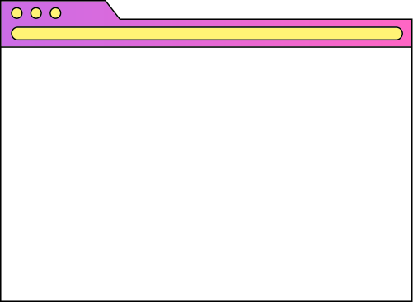




Flattening
The
Pyramid
Establishing Non-Hierarchy in
Traditionally Hierarchical Staff Structures
Elliot Baker and Kyle LaChance

Slide 2



Welcome to the Presentation
We’re Elliot and Kyle. If you ever want to reach us, contact financeoffice@icc.coop or reach our member VP at vp.finance@icc.coop

Slide 3

Session Flow
01
Introduction
03
Integration
02
Background
04
Discussion/Closings

Slide 4

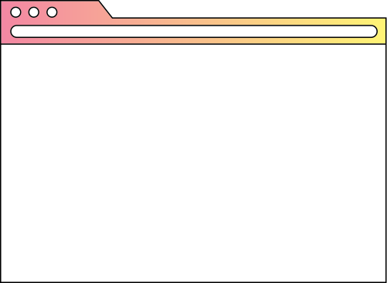



Who are we?
01
Introduction
Introduction

Slide 5

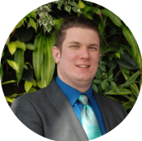
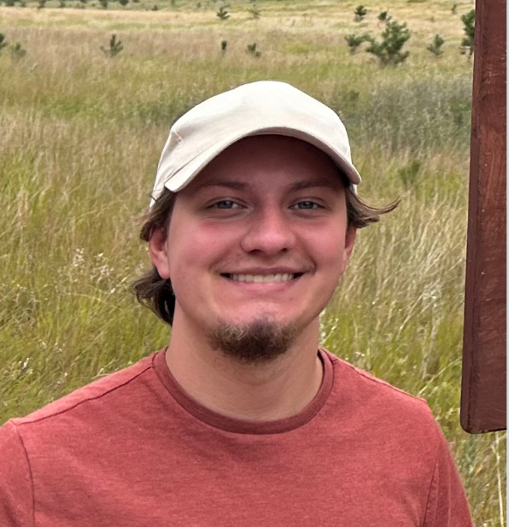
Who We Are
Kyle LaChance
Elliot Baker
House Accounts and Accounts Payable
Finance Liaison and Central Accounting

Slide 6



Who are we?
What do we do?
Inter-Cooperative Council of ann Arbor

Slide 7
What led to the flattening of hierarchy
02
Background
Background

Slide 8


Refined plan, implemented recommendations from Wholehearted
2024
Began work with Wholehearted Bookkeeping Cooperative to develop a new finance team structure
Structure updated to reflect cooperative model of member engagement
2023
2025
Timeline
Chaos
Past
Future

Slide 9







Why Change?
01
02
Structural
Work-Life Balance
03
04
05
Member Engagement
Accountability & Transparency
Collective Bargaining

Slide 10
Why Change?
01
02
Structural
Work-Life Balance
03
04
05
Member Engagement
Accountability & Transparency
Collective Bargaining

Slide 11

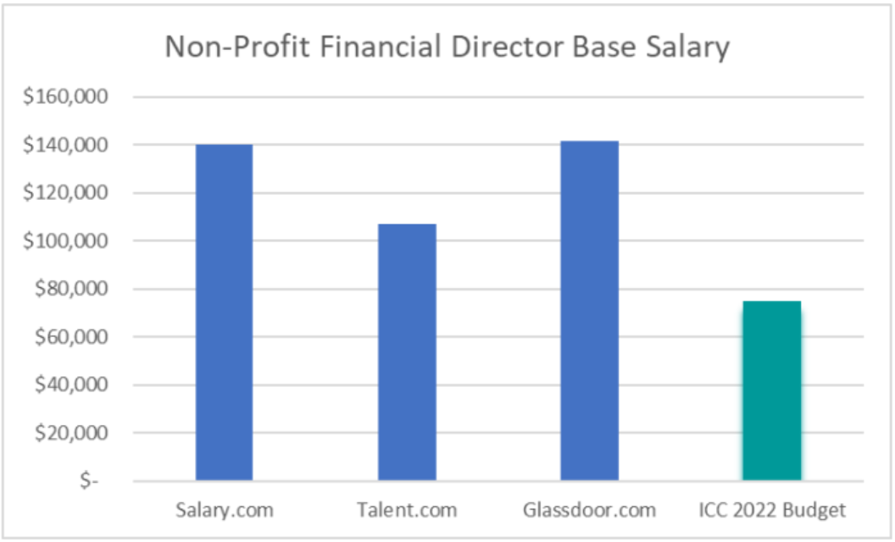
Affordability
Salary too high to stay affordable

Slide 12

Why Change?
01
Structural

Slide 13
What the structure allows
1.5
Integration
Integration

Slide 14
Why Change?
02
Work-Life Balance

Slide 15
Why Change?
03
Member Engagement

Slide 16
Why Change?
04
Accountability and Transperency

Slide 17
Why Change?
05
Collective Bargaining

