Slide 1

Seeing the Elephant:
Cross-Sectoral Cooperative Awareness & Education
Cathy Statz
Outreach Specialist
International Centre for Co-operative Management, Saint Mary’s University
-
Cooperative Outreach Specialist
NCBA CLUSA

Slide 2


Cathy, with a door prize mug donated by Cenex (now CHS, Inc., the largest co-op in the USA) at one of the gazillion co-op or Farmers Union meetings she attended as a child.
Cathy Statz NCBA CLUSA • Cooperative Development Foundation
International Centre for Co-operative Management, Saint Mary’s University
National Farmers Union • Ralph K. Morris Foundation

Slide 3
After spending 30 years supporting the Farmers Union youth and summer camp programs, I moved abroad with my spouse, who was teaching internationally... ...but I couldn’t imagine not educating about cooperatives.

Slide 4
cooperambulation: cooperatives (co-ops) + perambulating (to travel in a
leisurely manner)

Slide 5
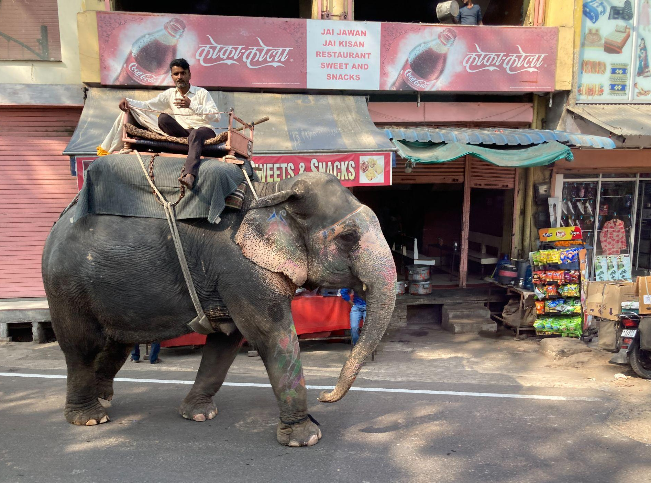


Slide 6
IYC 2025
Year of Cooperatives
THE BACKGROUND
-including the role of education
THE ELEPHANT
THE PILLARS / GOAL(S)
THE ACTION

Slide 7

THE BACKGROUND:
The United Nations has declared
2025
as the
INTERNATIONAL
YEAR OF COOPERATIVES
The International Cooperative Alliance (ICA) serves as the global coordinator, with the US activities managed by the National Cooperative Business Association (NCBA CLUSA International).

Slide 8
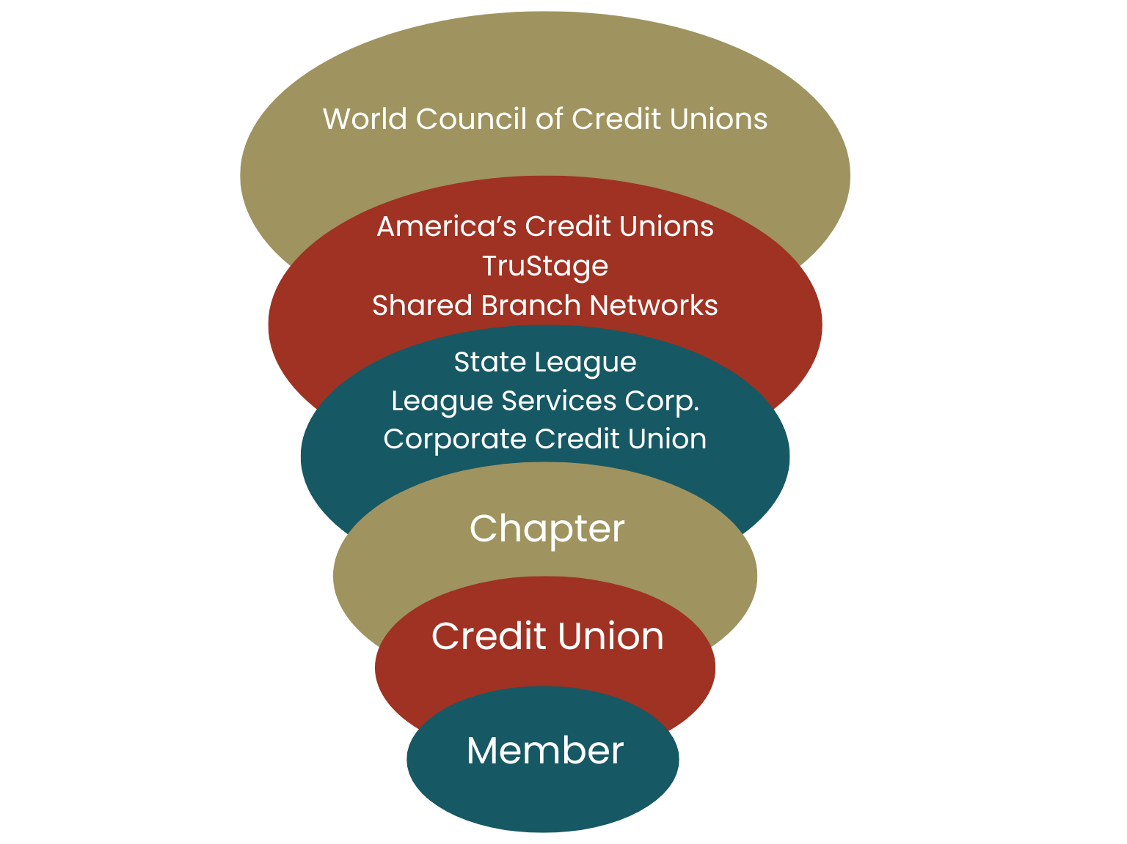
Cooperative sectors have structured systems to:
- advocate - support - develop - fund - educate

Slide 9
US Members of the International Cooperative Alliance (ICA) include:
America’s Credit Unions (formerly CUNA)
National Cooperative Business Association (NCBA CLUSA)
National Cooperative Grocers Association (NCG)
National Rural Electric Cooperative Association (NRECA)
Nationwide Mutual Insurance Company
National Cooperative Bank (NCB)

Slide 10


International Cooperative Alliance (ICA)
Cooperative Definition
A cooperative is an autonomous association of persons united voluntarily to meet their common economic, social and cultural needs and aspirations through a jointly-owned and democratically-controlled enterprise.

Slide 11
International Cooperative Alliance (ICA)
Cooperative Definition
A cooperative is:
an autonomous association of persons
united voluntarily
to meet their common
economic,
social, and
cultural
needs and aspirations
through a
jointly-owned and
democratically-controlled
enterprise.

Slide 12
International Cooperative Alliance (ICA)
Cooperative Definition
A cooperative is:
an autonomous association of persons
united voluntarily
to meet their common
economic,
social, and
cultural
needs and aspirations
through a
jointly-owned and
democratically-controlled
enterprise.

Slide 13
International Cooperative Alliance (ICA)
Cooperative Values
Cooperatives are based on the values of
self-help,
self-responsibility,
democracy,
equality,
equity, and
solidarity.
In the tradition of their founders, cooperative members believe in the ethical values of
honesty,
openness,
social responsibility, and
caring for others.

Slide 14
International Cooperative Alliance (ICA)
Cooperative Principles
The Cooperative Principles
Voluntary & Open Membership
Democratic Member Control
Members' Economic Participation
Autonomy & Independence
Education, Training and Information
Cooperation among Cooperatives
Concern for Community

Slide 15
International Cooperative Alliance (ICA)
Cooperative Principles
The Cooperative Principles
Voluntary & Open Membership
Democratic Member Control
Members' Economic Participation
Autonomy & Independence
Education, Training and Information
Cooperation among Cooperatives
Concern for Community

Slide 16
International Cooperative Alliance (ICA)
Cooperative Principles
The Cooperative Principles
Voluntary & Open Membership
Democratic Member Control
Members' Economic Participation
Autonomy & Independence
Education, Training and Information
Cooperation among Cooperatives
Concern for Community
NB: There is a global review of the cooperative identity underway; this has happened about every 30 years since the “Rochdale Principles” were officially adopted by the ICA in 1937.

Slide 17

International Cooperative Alliance (ICA)
Cooperative Principle 5:
Education, Training,
& Information
Cooperatives provide education and training for their members, elected representatives, managers, and employees so they can contribute effectively to the development of their cooperatives.
They inform the general public – particularly young people and opinion leaders – about the nature and benefits of cooperation.

Slide 18

From ICA Guidance Notes on the Cooperative Principles:
“Information” is a duty to make sure that others who are members of the general public, but particularly young people and opinion leaders, know about co-operative enterprise.
The knowledge to be imparted by information is not just a marketing exercise about a co-operative or the services it provides, nor is it propaganda.
It is a duty to inform the wider public about the values and principles-based nature of co-operative enterprise and the wider benefits to human society co-operative enterprise brings.
Too many co-operatives in too many countries ignore this responsibility.
INFORMATION

Slide 19

From ICA Guidance Notes on the Cooperative Principles:
“Training” is about developing the practical skills members and employees need to run a co-operative in accordance with efficient and ethical business practices and to democratically control their co-operative business responsibly and transparently.
In all co-operatives there is also a need for training of employees and elected officers in order to run the business of a co-operative efficiently in a competitive economy.
TRAINING

Slide 20


From ICA Guidance Notes on the Cooperative Principles:
“Education” is about understanding the Co-operative Principles and Values and knowing how to apply them in the day-to-day operations of a co-operative business.
It is also concerned with the wider education offered to members for their social development.
Co-operative education involves engaging the minds of members, elected leaders, managers and employees so that they comprehend fully the complexity and richness of co-operative thought and action and its social impact.
EDUCATION

Slide 21

A LITTLE LATIN VOCABULARY…
Educare: "to train or mold“
Educere: "to lead out“
Both senses are included in our (just one) English word:
Education

Slide 22
Another way of looking at these three words…
Information
Training
Education
The “What”
Facts, data, statistics… knowing the principles, definitions, basic knowledge of the difference from IOCs, etc.
TRAINING OR MOLDING
The “How”
Member participation, board governance, staff awareness of legal & accounting, communications skills, etc.
TRAINING OR MOLDING
The “Why”
Transformation, changing of hearts and minds; true understanding of the goals of cooperation, serving as an ambassador to others, community impact, etc.
THE LEADING OUT

Slide 23
“This educational relationship of
educare | educere
leads everyone to participate in the great democratic conversation of the world...
...In fact, education only has meaning in terms of an active and democratic participation in the human condition.”
~André Martin
L'Université de Sherbrooke

Slide 24
How do we connect Principle 5 (Education, Training, & Information)…
…with Principle 6 (Cooperation Among Cooperatives)?

Slide 25
Cooperatives help their members…
EARN more (PRODUCER.)
SAVE more & SERVE more (CONSUMER)
CONTROL more (WORKER)
SHARE MORE (PURCHASING)
INCLUDE MORE (MULTI-STAKEHOLDER)

Slide 26












Cooperatives help their members… EARN more Producer-based co-ops: ag marketing, processing, etc.

Slide 27








Cooperatives help their members… SAVE more Retail-based co-ops: ag supply, fuel, food, consumer goods, etc.
SERVE more Service-based co-ops:
energy, telephone, housing, financial services, etc.

Slide 28






Cooperatives help their members… SHARE more Purchasing and shared services co-ops: wholesale purchasing, benefits & branding

Slide 29





Cooperatives help their members… CONTROL more Worker co-ops: employee ownership

Slide 30





Cooperatives help their members… INCLUDE more Hybrid or Multi-Stakeholder co-ops

Slide 31
All of the above can participate in the Year of Cooperatives, either singly, with their sectors, and/or with the larger co-op ecosystem.
What might that look like?
But first–what is a barrier to this, and to general understanding & awareness of cooperatives?

Slide 32

Let’s talk about the elephant in the room.

Slide 33

THE BLIND FOLK &
THE ELEPHANT: AN ANCIENT PARABLE
Reimagined by John Godfrey Saxe in the 19th century
(And modified a little bit by me in the 21st.)

Slide 34
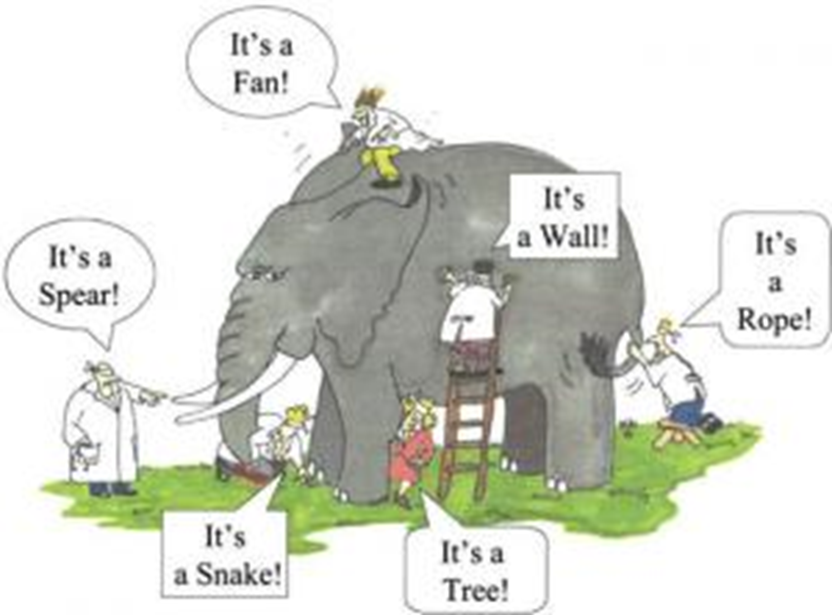

Slide 35
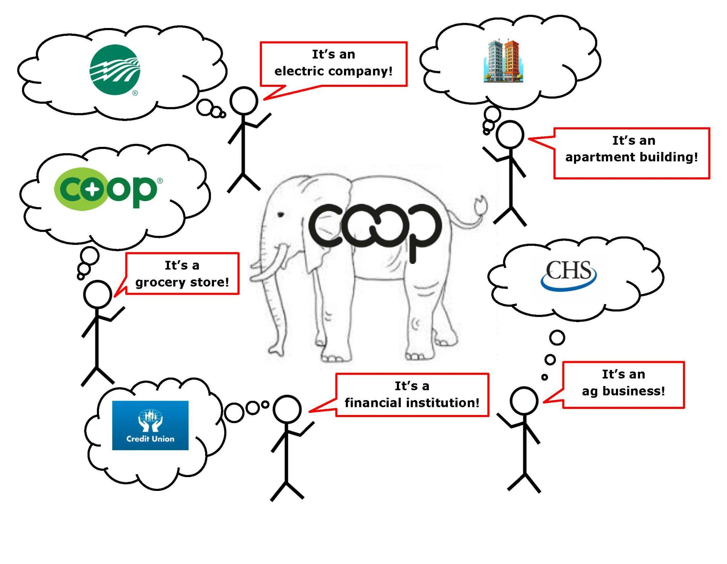

Slide 36
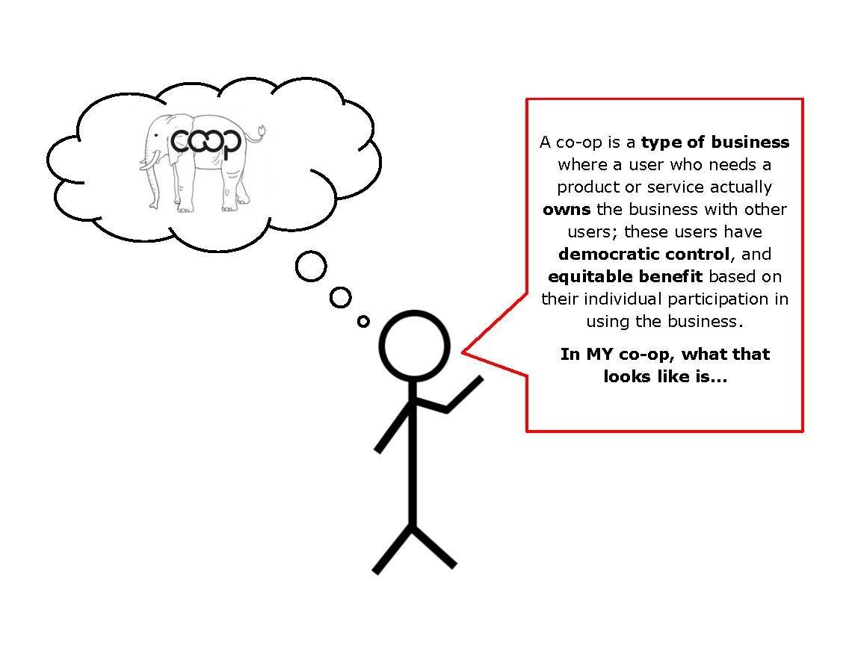

Slide 37
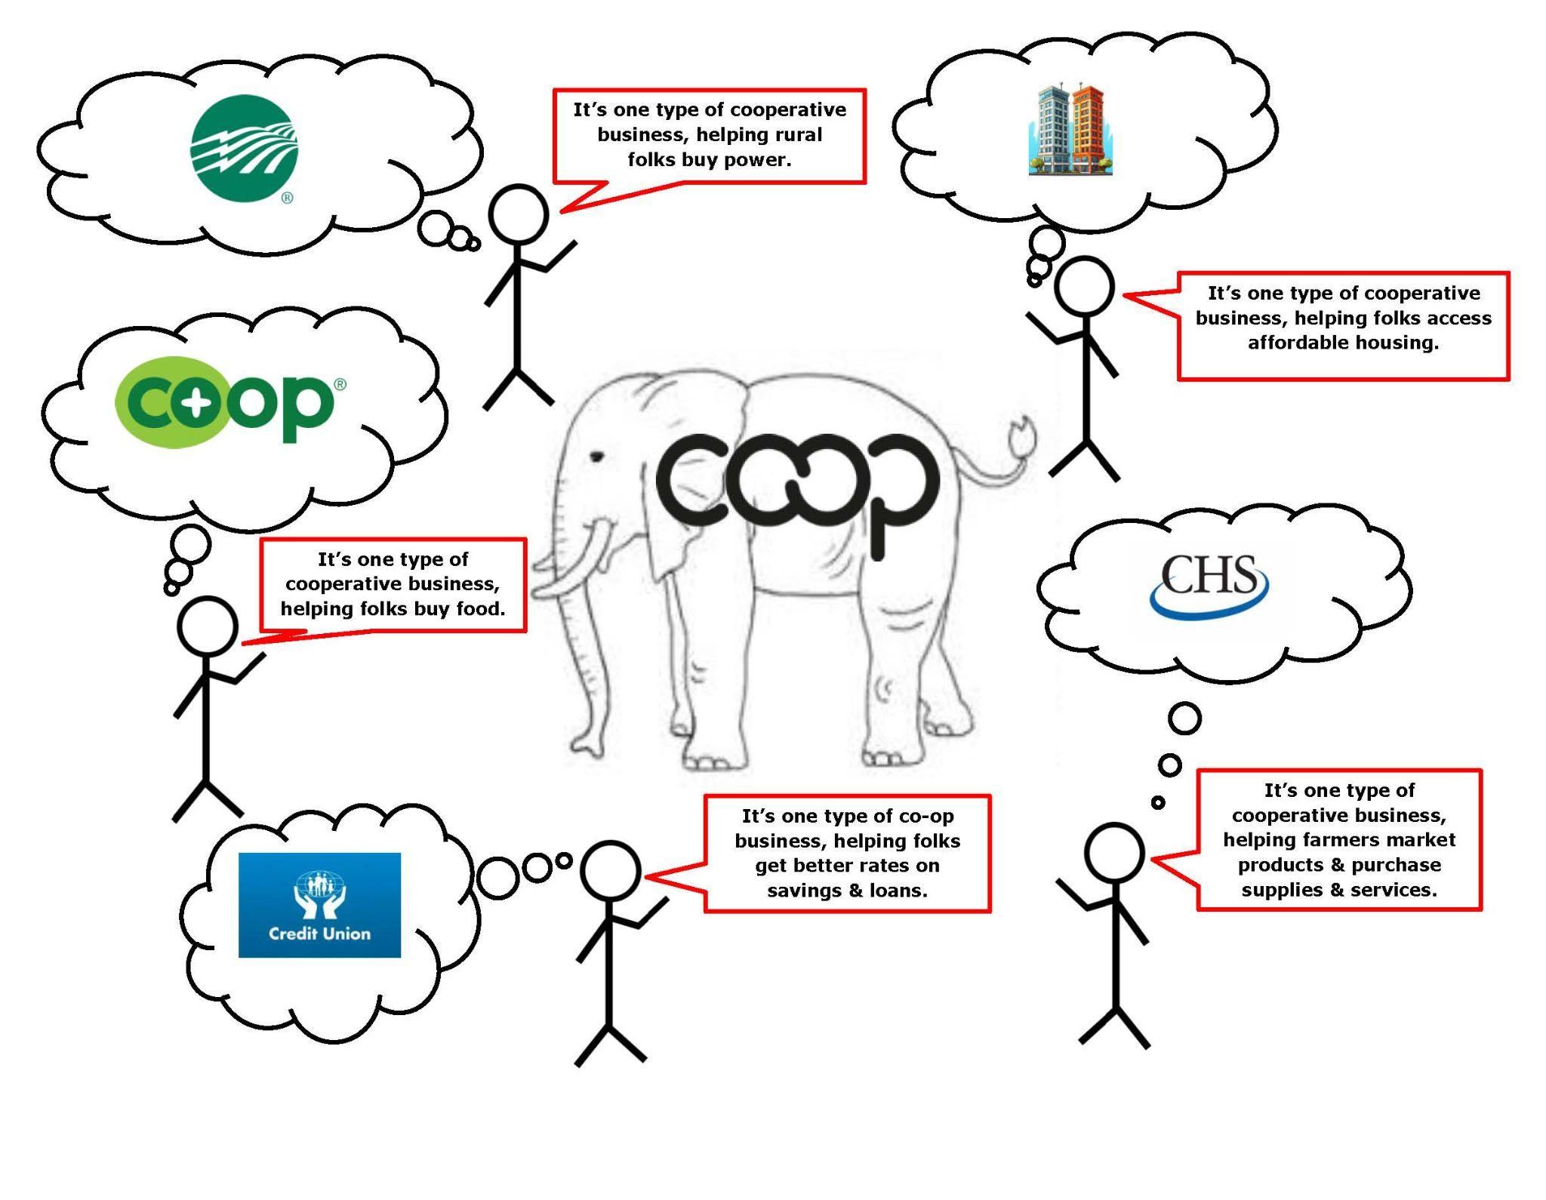

Slide 38

THE PILLARS / GOALS:
International objectives of the IYC 2025 are to:

Slide 39
THE PILLARS / GOALS:
NCBA goals for IYC 2025
During the Year of Cooperatives, NCBA worked to advance three key goals:
1) raising public awareness of how co-ops impact the economy and society,
2) advocating for legal and policy frameworks that support co-op development and enable co-op entrepreneurship, and
3) inspiring the next generation of cooperators.

Slide 40
THE PILLARS / GOALS:
NCBA goals for IYC 2025
Raising public awareness of how co-ops impact the economy and society:
Co-op Impact Report - a quantitative and qualitative footprint of cooperatives in the U.S.
Year of Cooperatives Toolkit - a roadmap to raise awareness of your local co-op and how it fits into the global cooperative economy

Slide 41
THE PILLARS / GOALS:
NCBA goals for IYC 2025
Advocating for legal and policy frameworks that support co-op development and enable co-op entrepreneurship: - Protect fair tax treatment for cooperatives including working to extend the 199A deduction in the 2025 tax package; - Level the playing field within the U.S. Small Business Administration’s lending programs to support co-op conversions; - Preserve key investments to create a resilient and robust economy through cooperatives in housing, the care economy, food systems and rural America; and - Empower communities around the world through locally-led cooperative development.

Slide 42
THE PILLARS / GOALS:
NCBA goals for IYC 2025
Inspiring the next generation of cooperators:
Engage the Cooperative Leaders and Scholars cohort and alumni in lifting up co-ops as people-centered businesses that build a better world
Work alongside the International Cooperative Alliance’s Youth Network to ensure youth are included and integrated into our work during the Year of Cooperatives—and that young people in the U.S. can connect with their global counterparts

Slide 43
THE ACTION:
What can we do–and what are we already doing– to work toward these goals?
YOUR CO-OP 🌲🌲 YOUR SECTOR 🌲🌲 YOUR STATE
1) raising public awareness of how co-ops impact the economy and society,
2) advocating for legal and policy frameworks that support co-op development and enable co-op entrepreneurship, and
3) inspiring the next generation of cooperators.

Slide 44
Public Awareness:
Rotary (and other service) clubs
Library & community programs

Slide 45
Advocacy:
TBD closer to date: student co-op advocacy, efforts at NCBA CLUSA

Slide 46

Inspiring the Next Generation:
Cooperative Leaders & Scholars (application portal opens in Dec.; deadline is Feb. 3)

Slide 47
LET’S GO CO-OP
in 2025–
and beyond!
Thank you.

Slide 48
