Slide 2
GOALS:
Breakdown various forms of masculinity and masculine theory
Expand the definition of masculinity
Understand the concepts of sex, gender, social constructs, and power
Show the importance of resistance and challenge to norms
How our experiences and making “space” is important
How trauma impacts us
How we can affirm our identities while supporting others

Slide 3
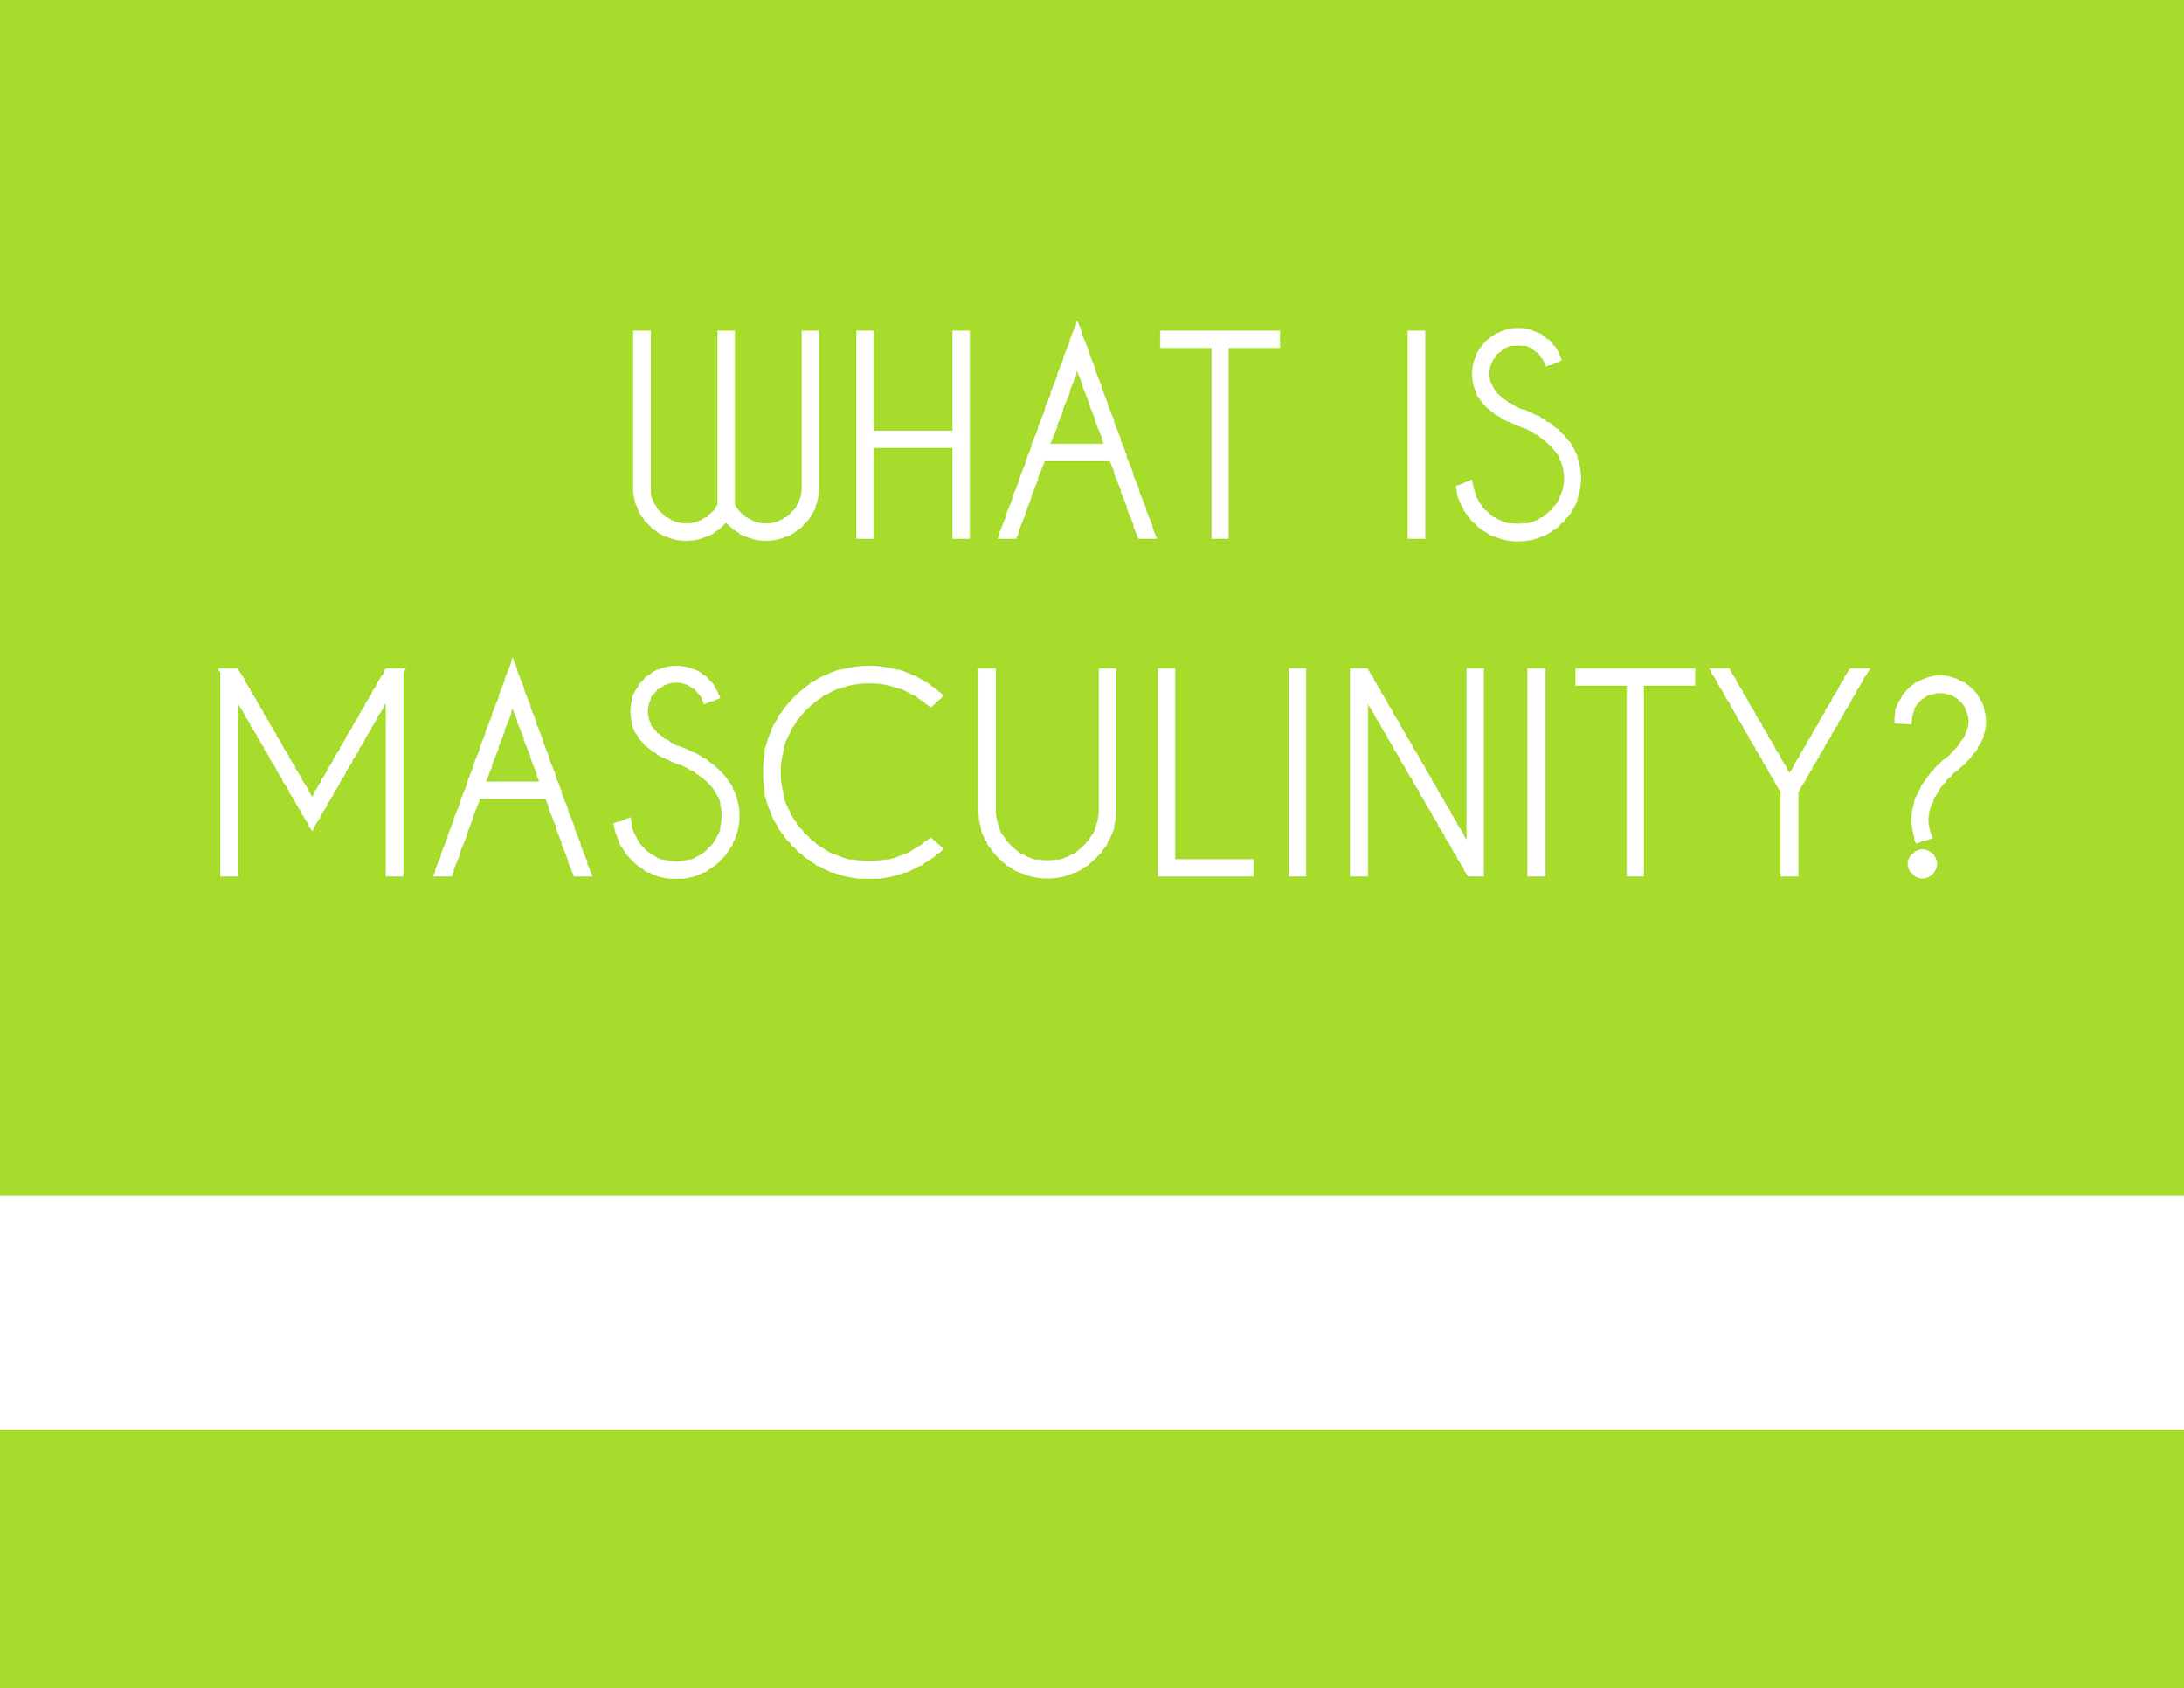

Slide 4
Expression
Characteristics

Slide 5
GENDER BINARY
a classification of sex and gender with distinct and opposite qualities i.e. male/men, masculine; female/women, feminine.
Cisgender / Cis: to identify with the same gender assigned at birth; cis is latin for “this/same side.”
Gender roles: norms dictating acceptable, appropriate, or desirable behaviors based on their actual or perceived sex.
Genderism/genderizing: to categorize by gender distinctions; systems or beliefs based on two genders and sexes.

Slide 6
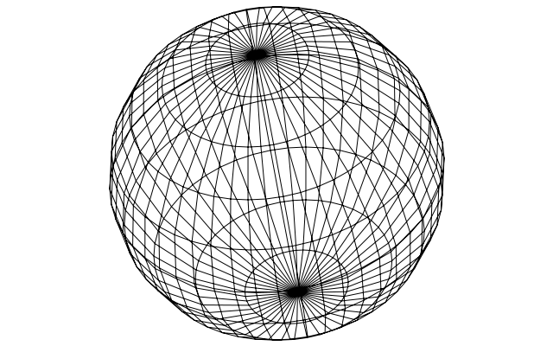
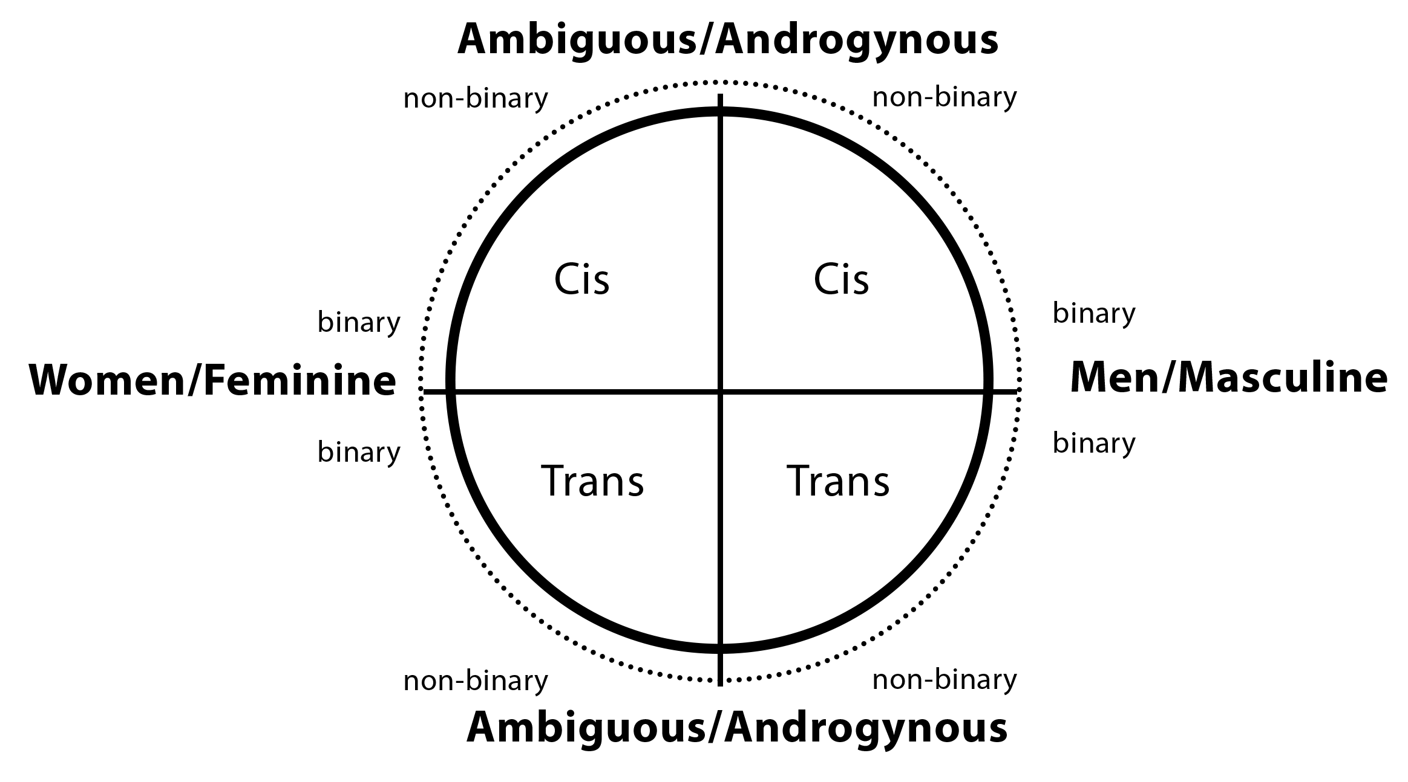
GENDER MODELS
Cis Women/Feminine
Cis Men/Masculine
1D
2D
3D

Slide 7
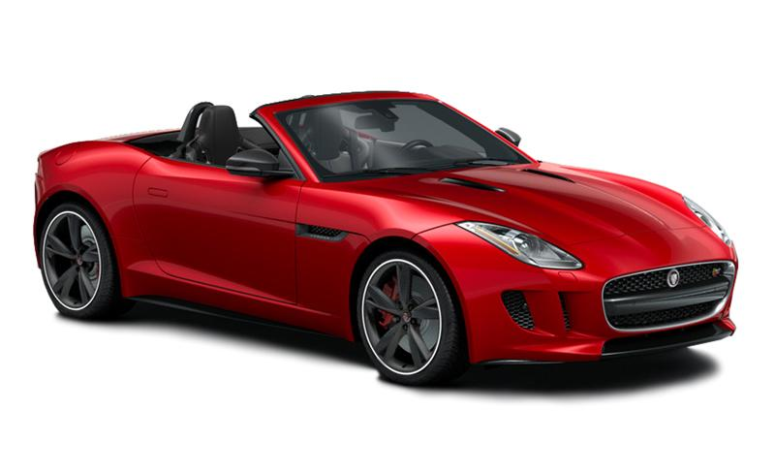
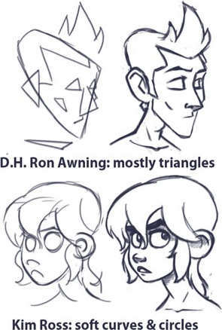
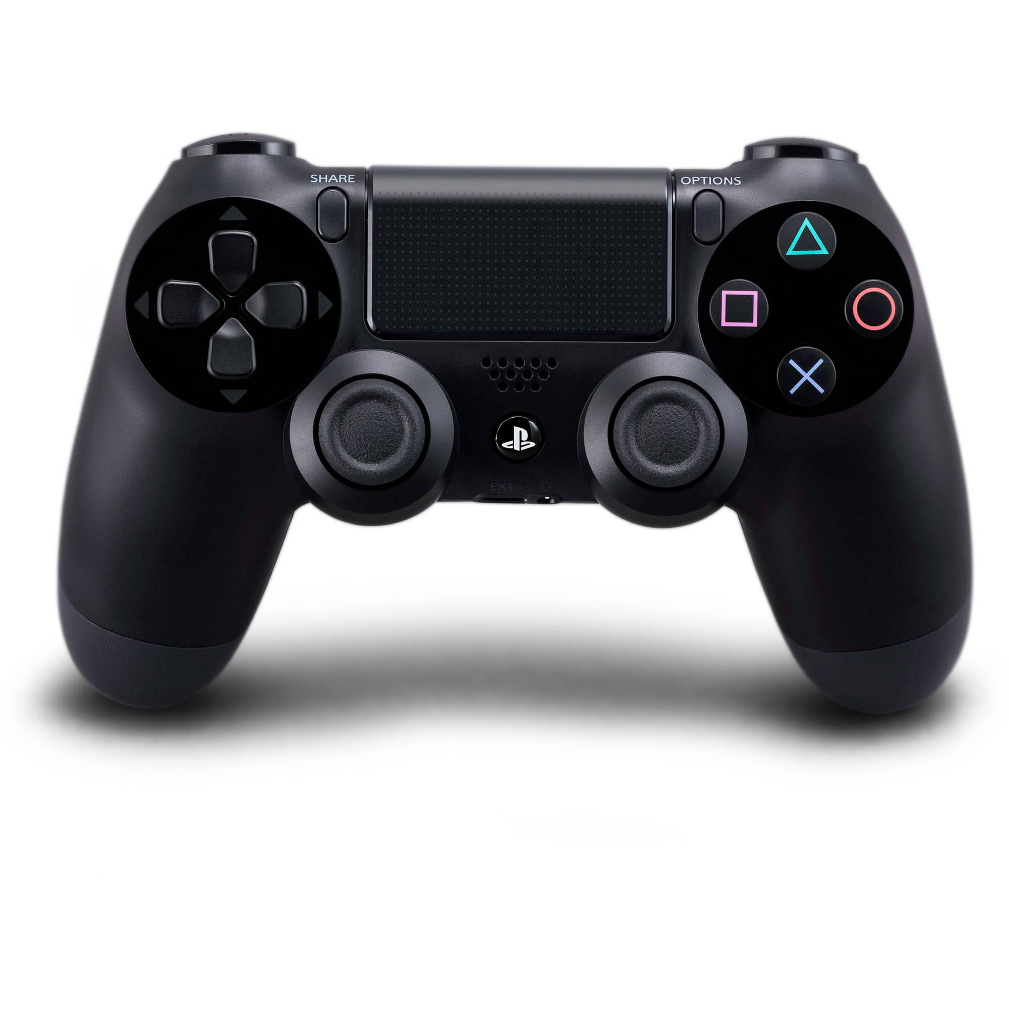
EXAMPLES OF GENDERISM

Slide 8
MASCULINITIES
Hegemonic complicit marginalized subordinate disabled phallic seminal/non-phallic toxic hypermasculine
masculine nurturance female masculinity butch/stud/dom butch-feme fragile masculinity decolonized
trans masculine “positive” masculinity traumatic

Slide 9
WESTERN HEGEMONIC MASCULINITY
Origins: The term “hegemonic masculinity” was developed by Australian sociologist, Raewyn Connell, in her 1987 paper “Gender and Power.” The concept is linked between masculinity studies, popular anxieties among men and boys, feminist theory and sociological gender models.
Definition: A highly valued minority group of men who adhere to behaviors and have characteristics aligning with the dominant society which subjugates women, femininity and heavily polices other men outside of or challenging the dominant society.

Slide 10
Characteristics:
Whiteness
Violence
Able Bodied
Passion
Honesty
Code-of-Ethics
Sexual
Intimidation
Heterosexuality
Fatherhood
Dominant/Competitive
Head-of-Household
Protector/Defender
Physically Strong/Active
Aggression/Toughness
Financial Provider/Professional
Large in size
Lack of emotion and empathy

Slide 11
Disabled Masculinity
Hegemonic traits:
physical strength, control of body and mind, sexual attraction/relationships, status
“…to expand their masculine repertoire… [they] reformulated or rejected hegemonic masculinity by ‘‘seeking emotional support’’ and ‘‘emphasizing sensitivity and interdependence””

Slide 15
GAME

Slide 16
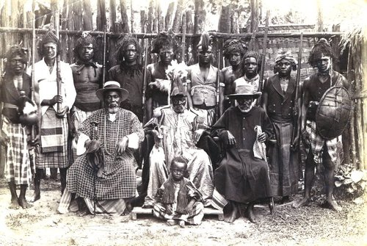
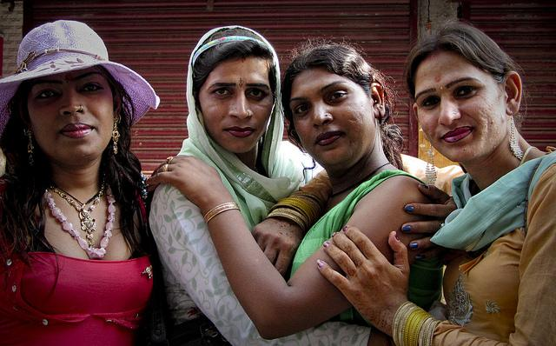
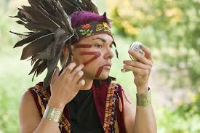
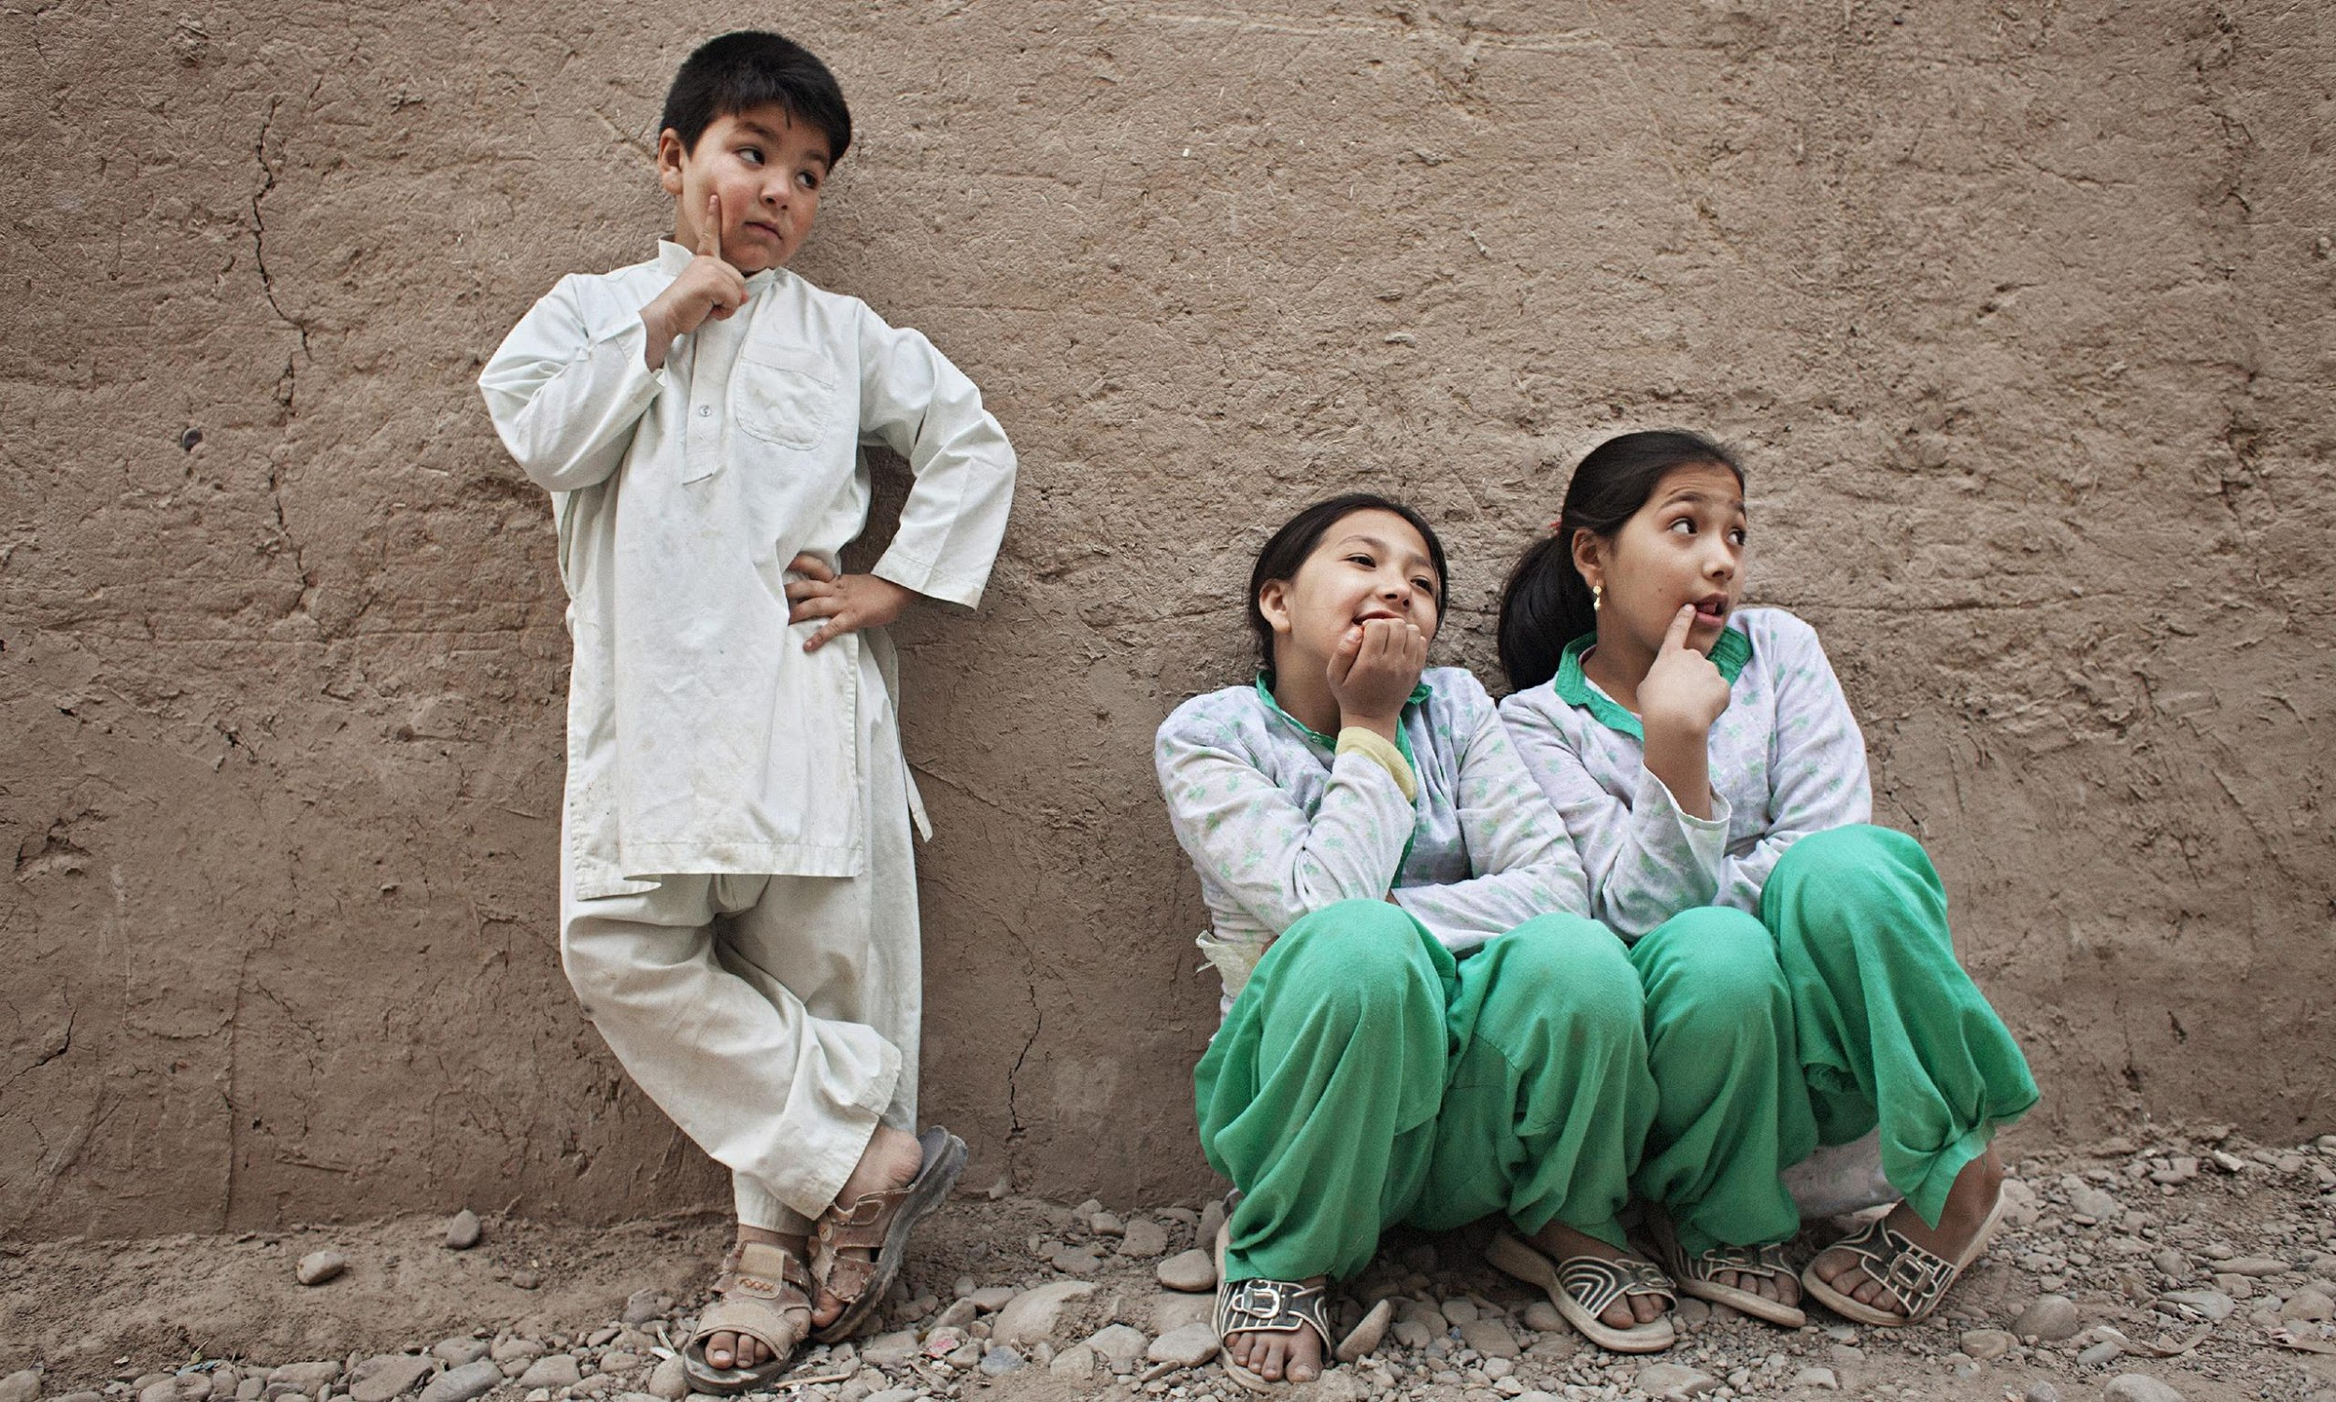
India, Pakistan, and Bangladesh : Hijra is an ancient non-binary role of birth assigned males who have feminine gender expression/identity.
Igbo, Nigeria: had concepts of female husbands, female sons, male wives, and male daughters.
Afghanistan and Pakistan: Bacha posh is a practice where families without sons pick a daughter to raise as a boy/son.
Navajo, portions of modern day Arizona, Utah, and New Mexico: Two-Spirit is a person who is both a masculine and a feminine spirit, or a different balance of masculine and feminine characteristics.

Slide 17
“You’re born a MAN OR a WOMAN.”

Slide 18
SEX-
Either of two main categories (male and female) into which humans and many other living things are divided into based on their reproductive organs or genitalia.
One X or Y | Monosomy or Turner Syndrome - are phenotypically female, abnormal growth patterns, are short in stature, generally lack prominent female secondary sexual characteristics and are sterile. | XXY or XY/XXY Mosaic | Klinefelter syndrome - phenotypically male, abnormal development of the testis, leading to hypogonadism and infertility.
XXX | phenotypically female, normal development of sexual traits and are fertile. | Hermaphroditism or Ovotestes - having sex glands containing both ovarian and testicular tissue, can be present in place of one or both ovaries or testes.
XYY | phenotypically male, higher than levels of testosterone, are typically fertile and many are unaware that they have a chromosomal abnormality. | Congenital Adrenal Hyperplasia or Adrenogenital Syndrome – can effect boys and girls, deficiency of cortisol, a steroid hormone produced by the adrenal cortex, prone to look more “masculine.”
XX Males and XY Females | XX males have a male appearance and male external genitalia. XY females have a female appearance and female external genitalia. | Androgen Insensitivity Syndrome - recessive X, external female genitalia and breast development despite being genetically male.
XXXXY | phenotypically male | Intersex - a general term used for a variety of conditions in which a person is born with a reproductive or sexual anatomy outside of XX female or XY males.

Slide 19
“Clearly, there are not only females who are XX and males who are XY, but rather, there is a range of chromosome complements, hormone balances, and phenotypic variations that determine sex.”
– (World Health Organization, “Gender and Genetics,” www.who.int/genomics/gender/)

Slide 20
GENDER SPECTRUM
Agender
Androgyne
Androgynous
Bigender
Cis Man
Cis Woman
Gender Fluid
Genderless
Gender Nonconforming
Gender Questioning
Gender Variant
Genderqueer
Intersex
Neither/Nongender
Neutrois
Non-binary
Other
Pangender
Trans*
Trans Man
Trans Woman
Transfeminine
Transmasculine
Two-Spirit

Slide 21
“Intersex people INTERRUPT the idea that there are only two biological sexes [and] transgender people INTERRUPT the idea that biological sex determines your gender.” - Ashley Wilde, YouTuber, “Gender as a Spectrum”

Slide 22
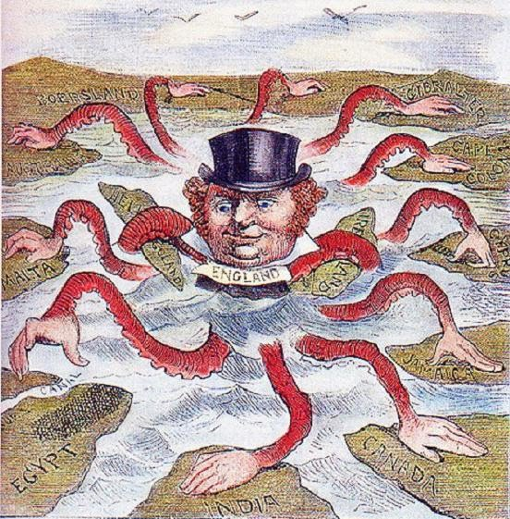
COLONIALISM
Colonization - the invading of land/territories for settlement and/or resource exploitation.

Slide 23
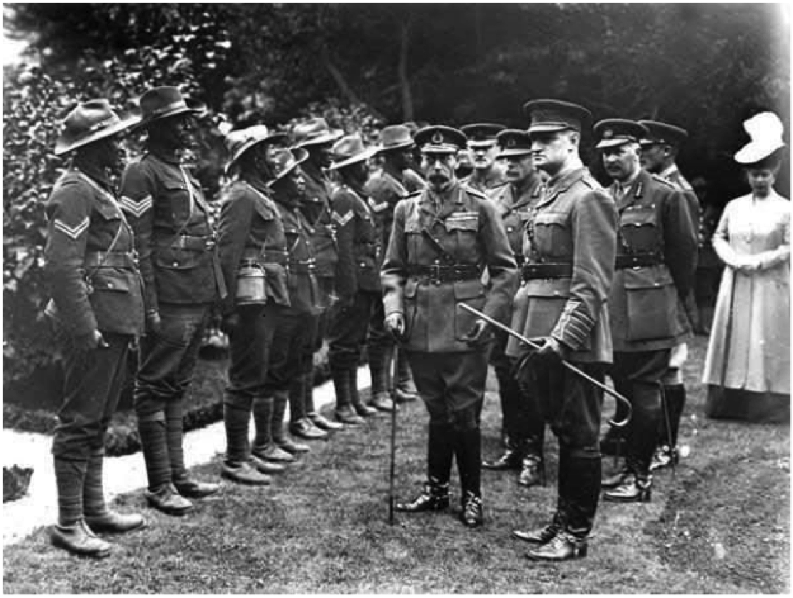
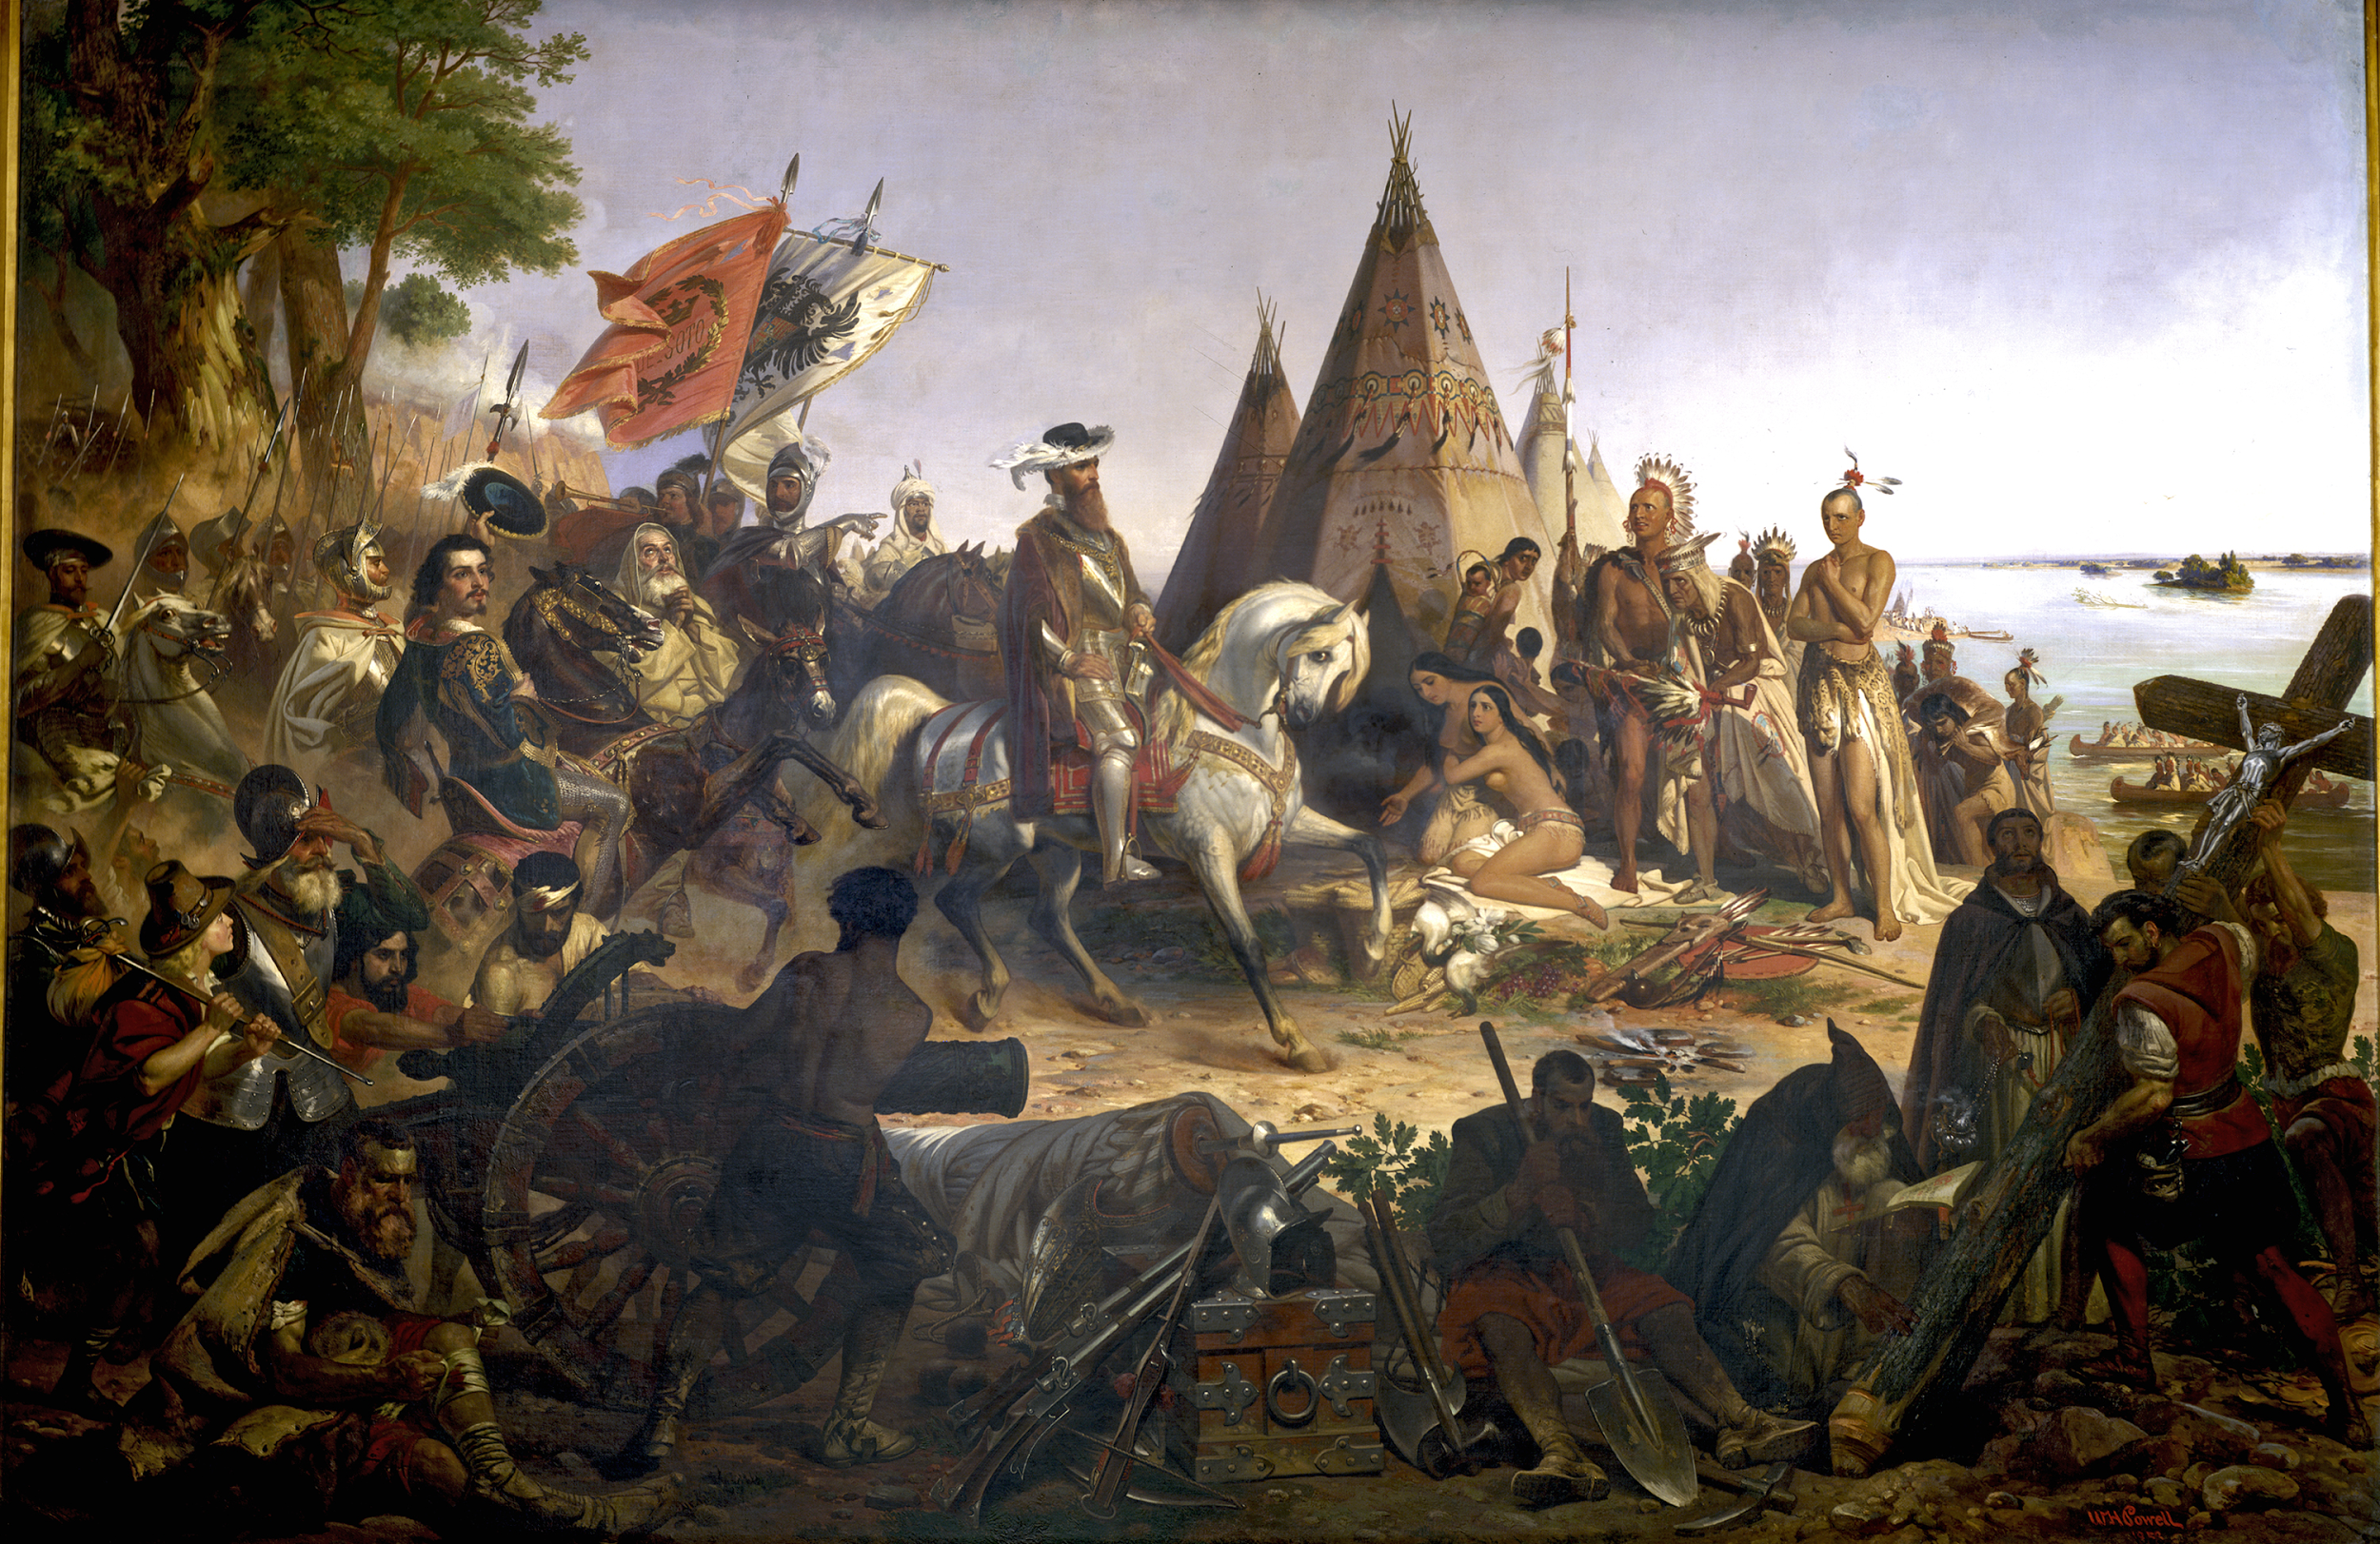
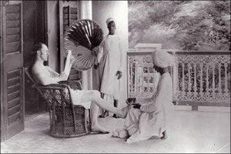
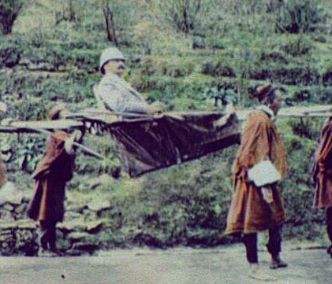
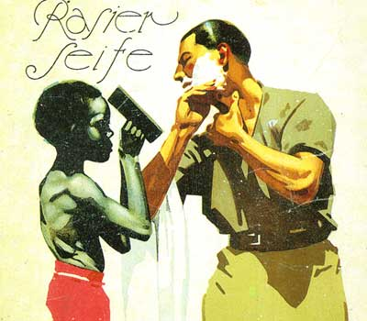

Slide 24
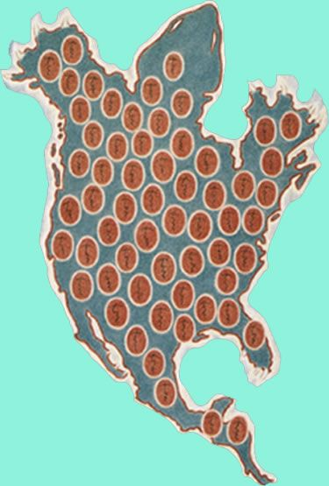
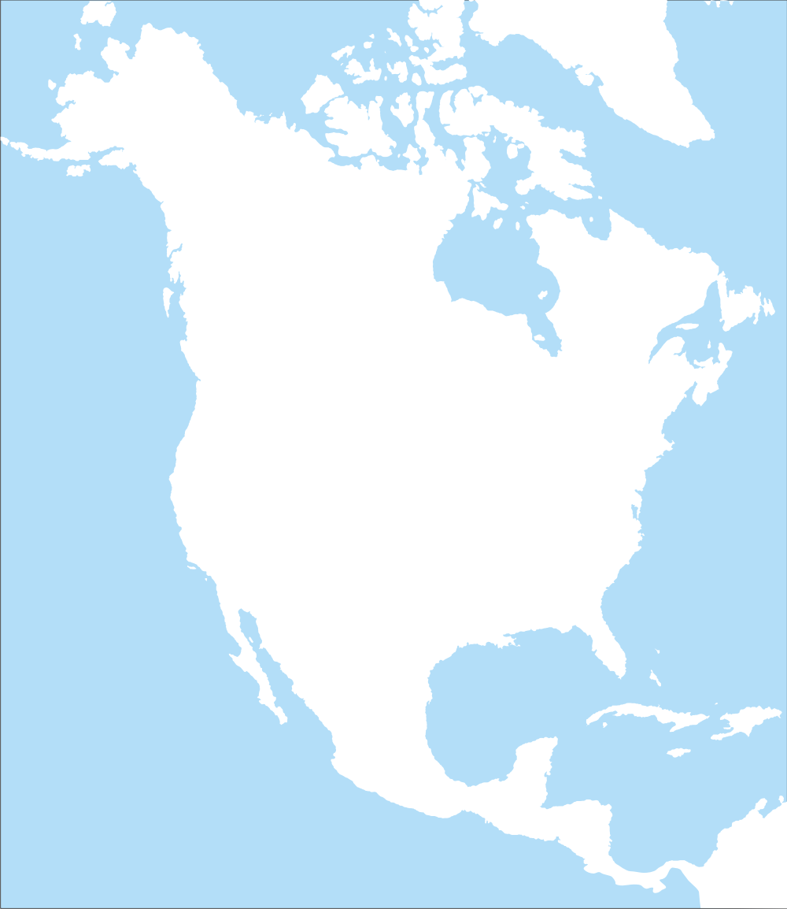
TURTLE ISLAND
Turtle Island is the original name and creation story of what we know as “North America,” which spans from sub arctic Inuit territories (Canada) to Kuna/Guna territories (Panama and Columbia) .

Slide 25
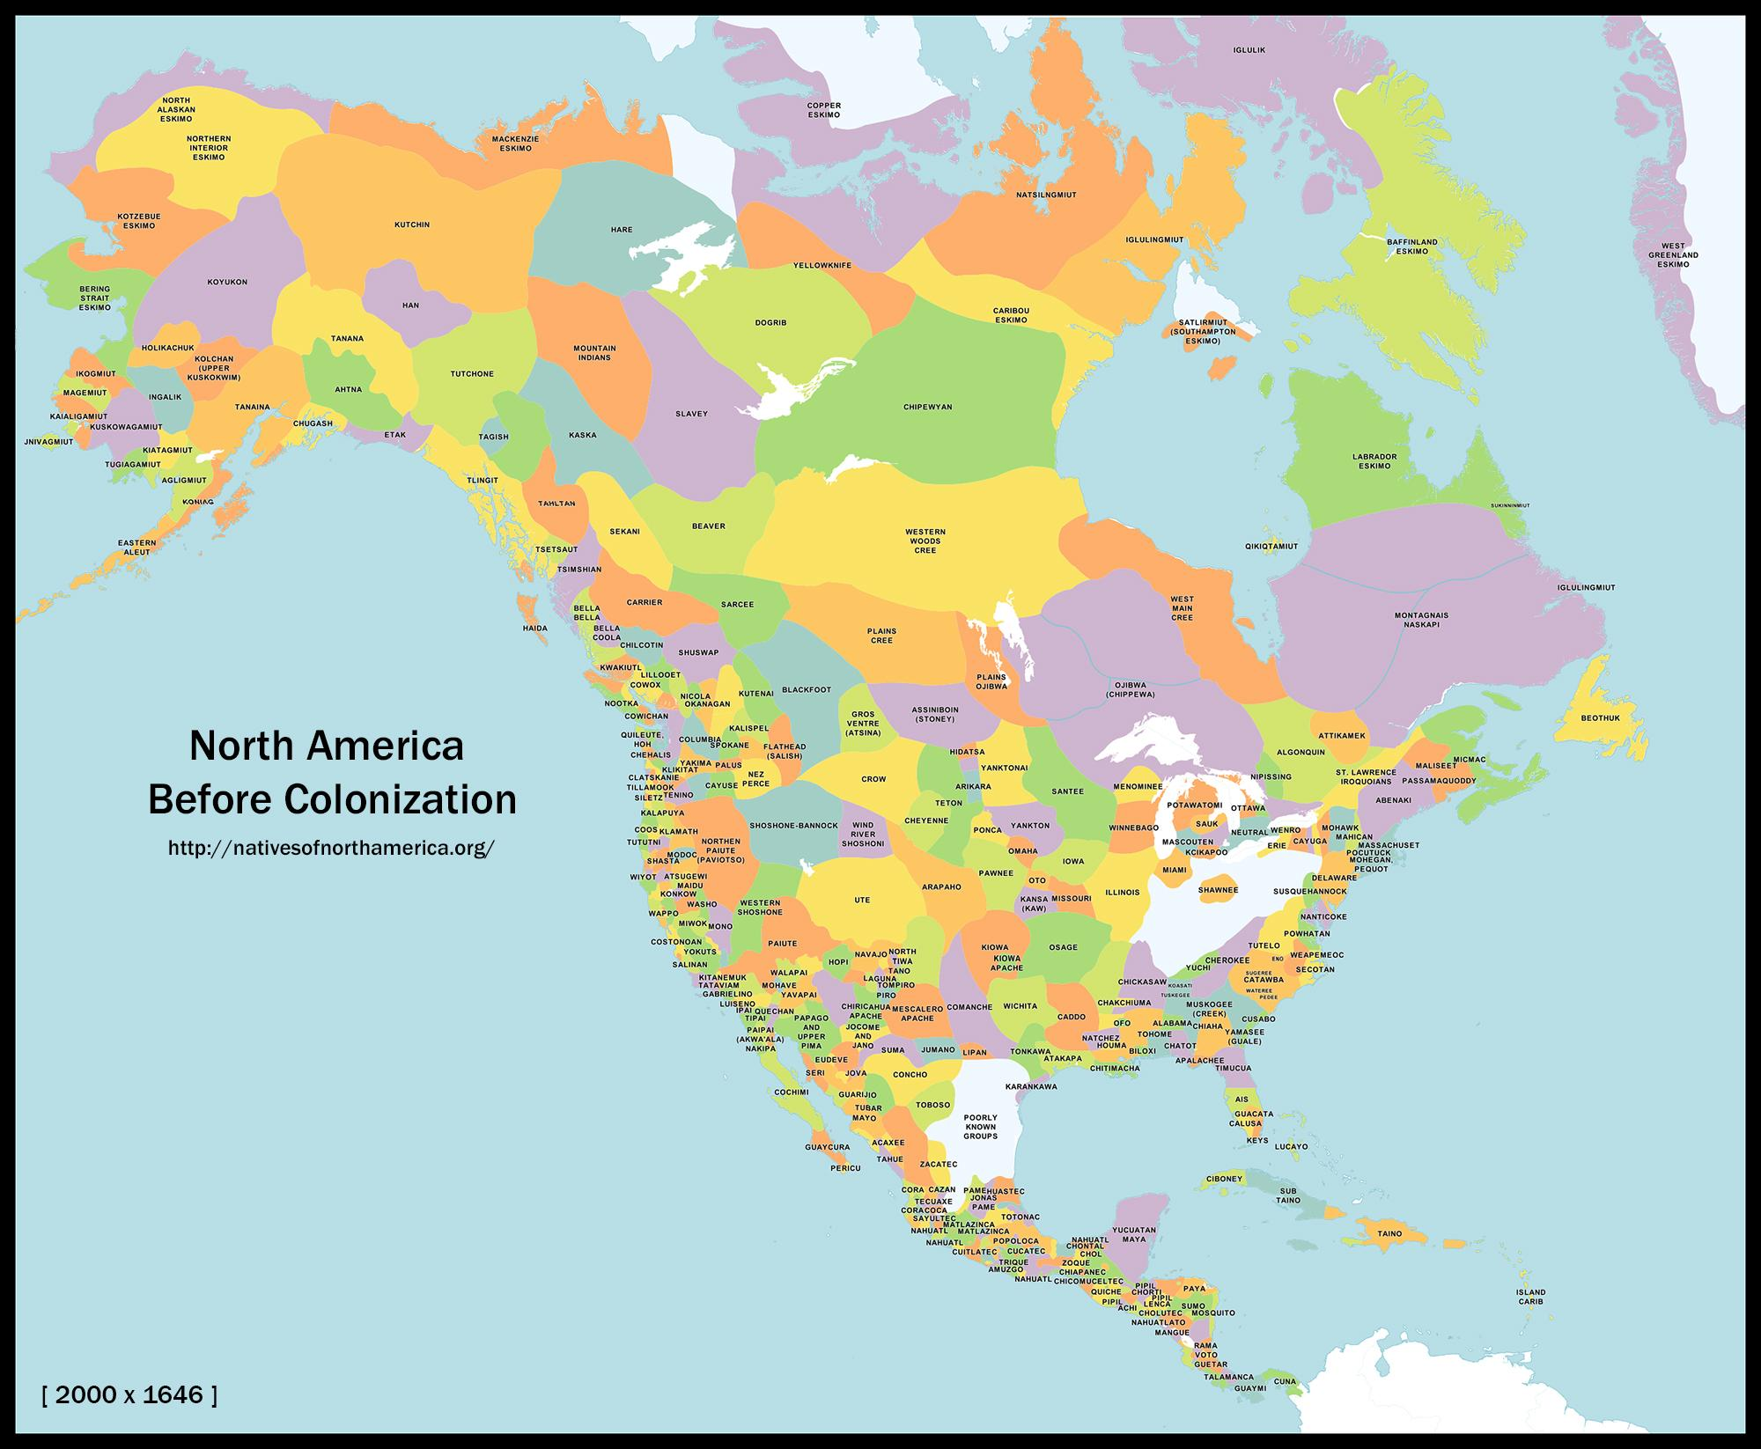

Slide 26
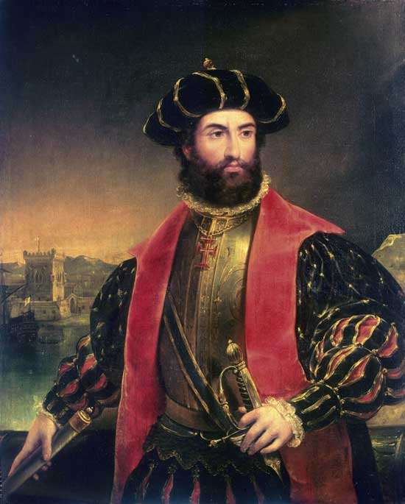
Amerigo Vespucci and the Present
An Italian explorer who sailed for the Spanish in 1499 until 1503. Vespucci had 4 voyages, traveling the Caribbean down to southern Argentina.
THE NAME: “America” came about from German mapmaker (cartographer) Martin Waldseemüller who named the north and south territories after Vespucci by feminizing “Amerigo” into “America.” His “New World” maps were dedicated to Vespucci and became popular in Europe.

Slide 27
NORMS:
POWER:
white / cis / male / hetero / able-bodied
International
Trade/Economic System
Spirituality/Belief System
white supremacy / cis supremacy / patriarchy / heteronormativity / ableism
Imperialism
Capitalism
Christianity
Prejudice v. Power v. Privilege

Slide 28
PREJUDICE

Slide 29
POWER

Slide 30
Quality of Life (QoL)
Violence
The general well-being of individuals and societies.
Healthcare
Politics/Law
Employment/Work/Financial Well Being
Emotional/Mental Wellbeing
Personal Safety
Justice and Prison System
Education
Water, Air, Food, Housing, and Infrastructure Quality
Physical
Emotional
Spiritual/Religious
Economical /Class
Mental
Sexual
Systemic/Institutional
Intra/intergenerational
Intra/intercommunal
National or International
Environmental

Slide 32
CENSURE-
within the masculinity hierarchy censuring is used to reprimand men to adhere to hegemony (western) or on men who cannot access it. This can be expressed through taunting, shaming, attacking, criminalizing, etc.
*The absence or lessening the possibility of censuring men within the dominant society is an invisible method in protecting and maintaining hegemonic masculinity.

Slide 33
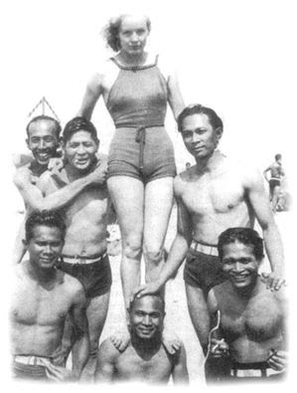
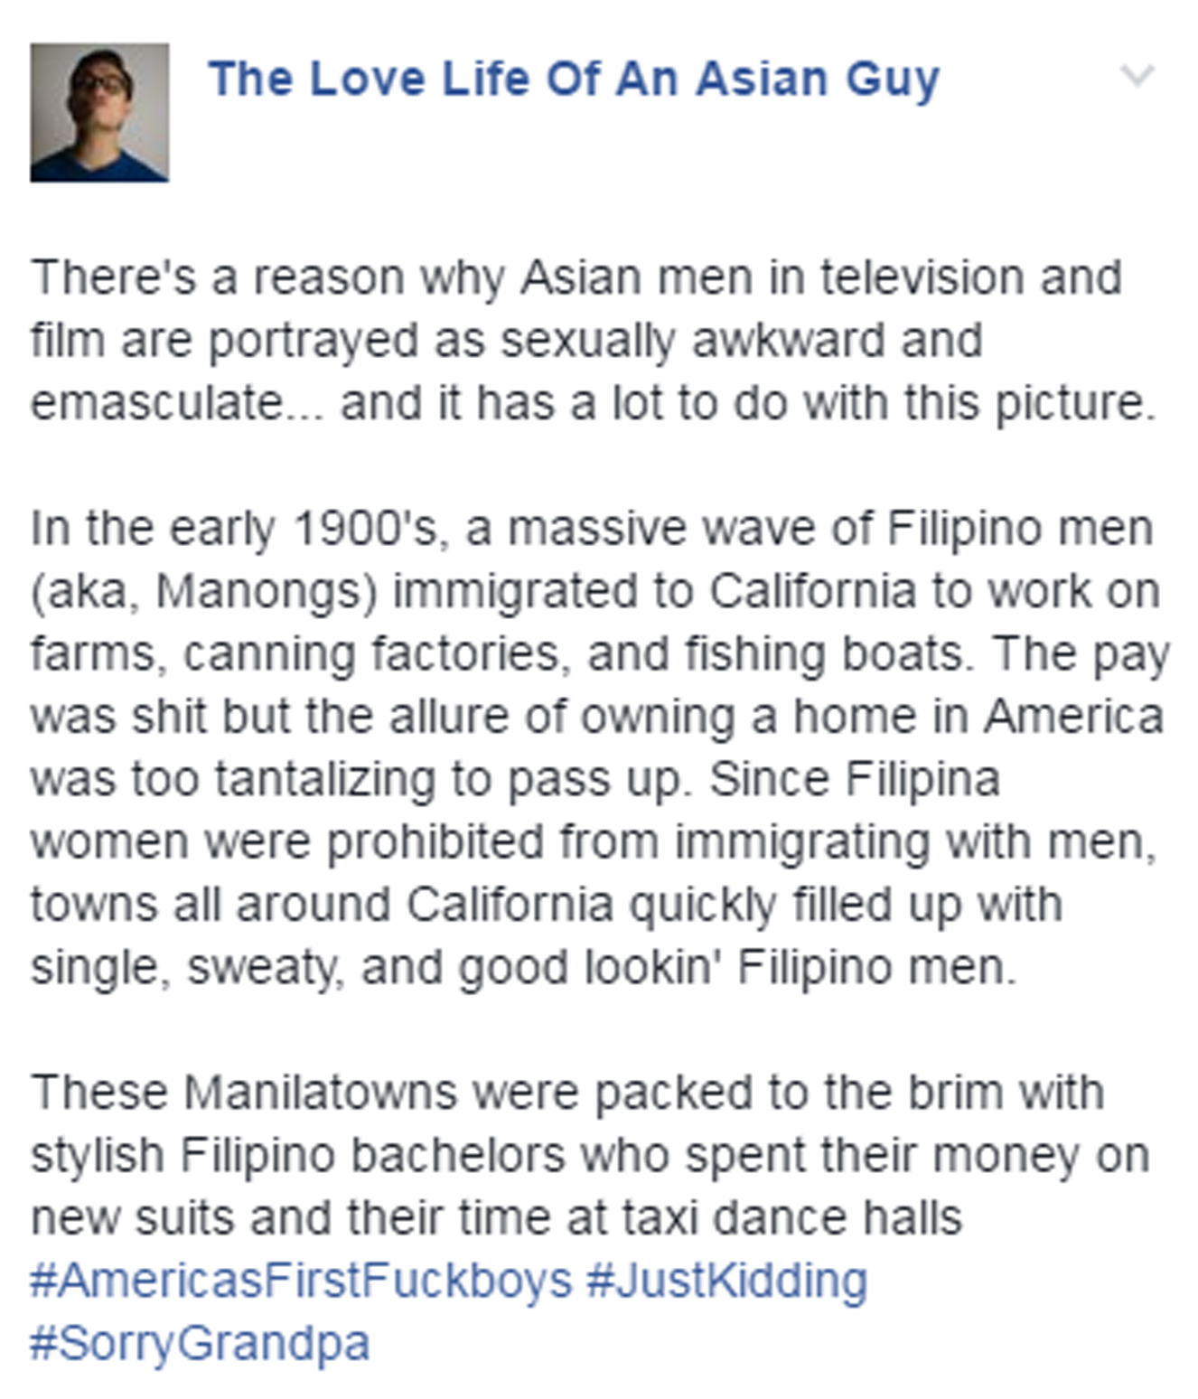
MARGINALIZED MASCULINITY

Slide 34
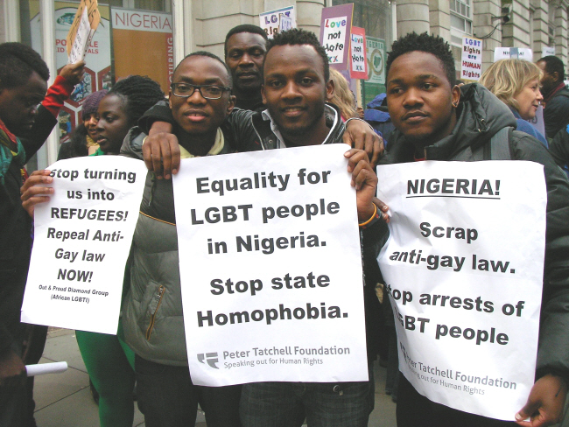
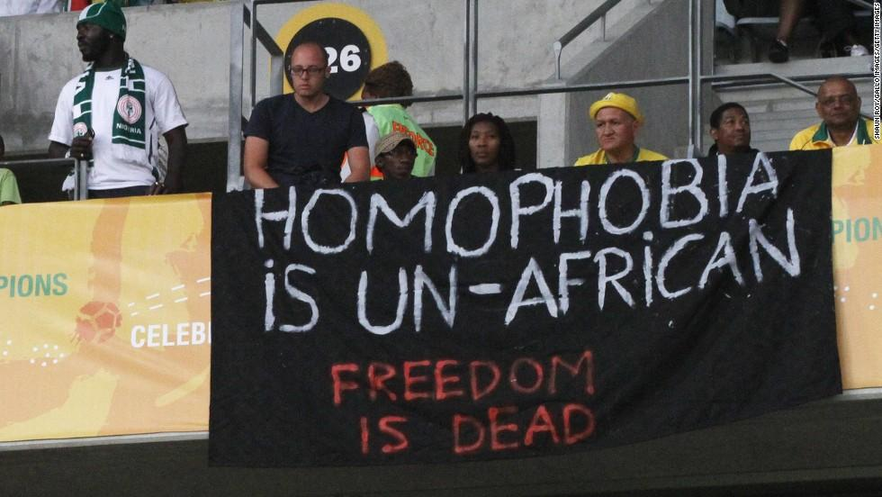
SUBORDINATE MASULINITY

Slide 35
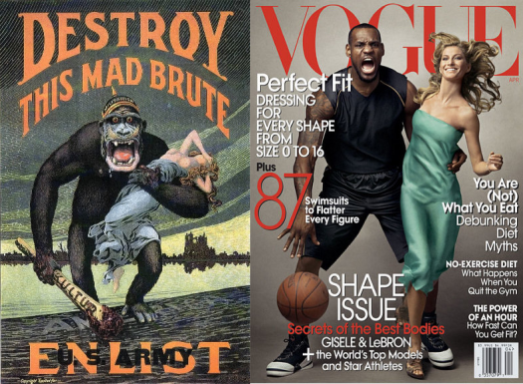
HYPERMASCULINITY

Slide 36
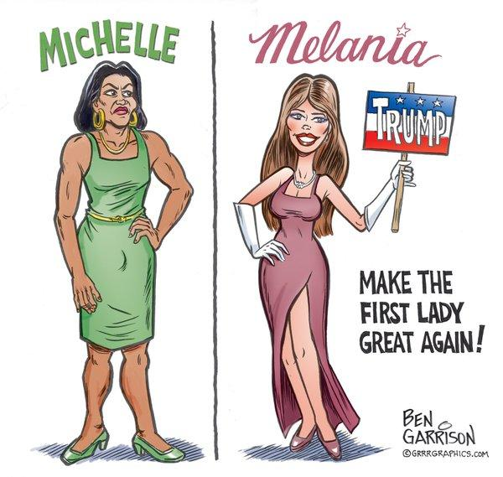

Slide 37
GAME

Slide 38
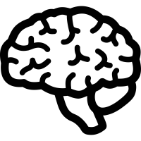
NARRATIVE (I.D.P.)
What is your masculine identity? And what is your relationship with masculinity?
IDEA | DEVELOPMENT | PRESENT
What is your idea and definition of masculinity? Values, characteristics, images, beliefs, etc. | How did you development your ideas of masculinity? What relationships have you had with masculinity? experiences, upbringing, relationships, etc. | Where are you now with your masculine identity and how do you feel about your present state? Are ideas and experiences with masculinity helping or hindering where you want to go and who you want to be?

