Slide 1
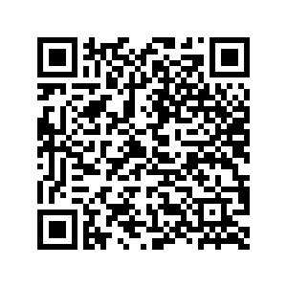
Trauma Stewardship
and Effecting Change

Slide 2
Trauma
Self Care
Non-profits

Slide 3
Oversimplification/Reduction

Slide 4
Strengths Based
Person Centered
Harm Reduction
Restorative Practices
Trauma Informed

Slide 5
Vicarious Trauma, Secondary Trauma, Burn Out, Compassion Fatigue

Slide 6
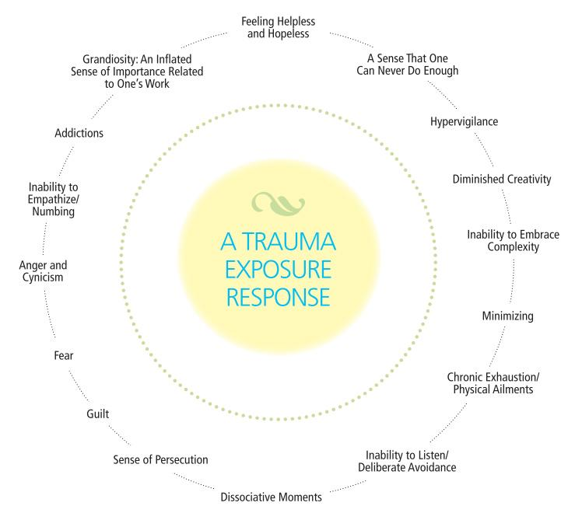

Slide 7
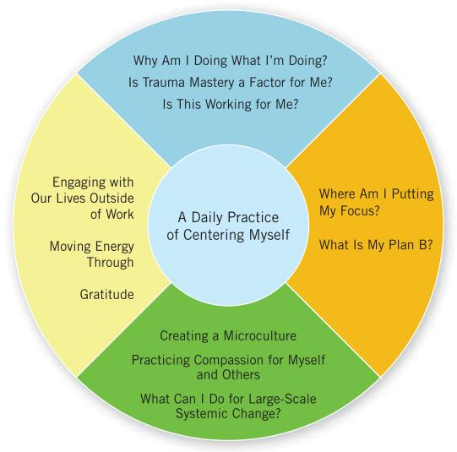

Slide 8

Seeking Balance (Air)
Engaging with our whole lives
Moving energy through
Gratitude

Slide 9
Compassion & Community (Earth)
Creating a microculture
Narratives & Pre-circles
Compassion for myself and others
Paradigm of change

Slide 10
Space for Inquiry (Water)
What am I doing?
Is this about Trauma Mastery?
Is this working?

Slide 11
Choosing our Focus (Fire)
Where am I putting my focus?
Service Rationing
Do I have a plan B?

Slide 12
DAILY CENTERING PRACTICE
Exercise, walking, driving, meditation, etc
Emotional vs Logical “knowing”

Slide 13
Self. Care.

Slide 14
Accepting what you are actually capable of
You can’t yoga so hard you no longer have a disability
Kale-onoscopy

Slide 15
Which ‘Self’ are you taking care of?
The fearful self, the destructive self, the submissive self, etc.
“The Two Wolves”

Slide 16
Care isn’t inherently ethically neutral
The families of cops provide care to the cop

Slide 17
Consumption or indulgence
Self care is not self indulgence
Relaxation and recovery
Fighting to change the systems
SEEK THE BALANCE

Slide 18
“Self care” in the stead of change
Offloading of responsibility from harmer to harmed

Slide 19
The Non-Profit Industrial Complex (NPIC)

Slide 20
Arsonists shouldn’t be in charge of the fire department
Fixing or healing is funded by the ones who created harm in the first place
Allows capitalists to de/legitamize or control what work gets done
Chasing grants/reporting and recording labor
Cycles of growth and collapse in orgs

Slide 21
Tax evasion and reputation laundering
“Donate to charity” frequently actually means “put in a tax haven that I still control”
Throw a proportionately small amount of money at a cause to fix bad PR

Slide 22
Top Down Organization
Capitalism but nice this time I swear
Why we yell about “liberals”

Slide 23
Professionalization
In order to fix the world you need to spend several years accruing $100K in student debt
De/legitimization
Conditioning
Burnout before you’ve even gotten anything done
Exclusionary language

Slide 24
Paradigm of Change
Systemic ---> Individual or Social
Criminalization
Isolation/Separation

Slide 25
Trauma Stewardship
Connie Burk & Laura van Dernoot Lipsky
Self As Other
Crimethinc
The Revolution Will Not Be Funded
INCITE! Women of Color Against Violence

