Slide 1
WE ARE NOT ALONE : STUDENT HOUSING ISSUES AND CO-OPS AROUND THE WORLD
Notes:
Enlever barre déroulante

Slide 2
ABOUT US
Both Members of CSU Housing Committee
Undergrad Students at Concordia
Notes:
Enlever barre déroulante

Slide 3
INTRODUCTION
A LARGER ACCESS TO EDUCATION
A MORE MOBILE STUDENT POPULATION
Notes:
More students have access to education, in general.
More students have access to universities abroad through: Exchange programs, more affordable plane tickets so students are much more mobile than ever.

Slide 4
INTRODUCTION
ACCOMMODATE
AN INCREASING NUMBER
OF STUDENTS
Notes:
Students don’t bring their parents with them to university so they usually need to find a place to live.
This means that there is an increasing need for student housing. This brings up the question of how/where to house these students?

Slide 5
INTRODUCTION
UNIVERSITY RESIDENCE HALLS
PRIVATE STUDENT HOUSING
STATE-OWNED HOUSING
COOPERATIVE HOUSING
Notes:
The fact that there are many students gives developers the opportunity to meet demand by building large (and usually expensive) apartment complexes.
Transformer l’avantage comparatif qu’ont les étudiants sur le marché locatif en opportunité pour construire des grands appartements à Montréal

Slide 6
CASE STUDIES
Notes:
The plan of the presentation is that we will give the context, analysis and a call to action for each case.
Melbourne, Australia
Edimbourg, Scotland (UK)
Seoul, Korea
Grenoble, France
Geneva
Montreal, Quebec, Canada

Slide 7
MELBOURNE
A VERY PRIVATE RESPONSE :
CATERING FOR INTERNATIONAL STUDENTS
Notes:
-90% of residences are private
-0 public residences
-only 10% institutional residences
-1% are student housing cooperatives and other models
A lot of international students → very private response → regulation to limit landlors abuse → 1 coop => enjeux autour du logement étudiant et la capacité du privé à en produire seul

Slide 8
MELBOURNE
Notes:
Melbourne
second biggest student population in Australia.

Slide 9
MELBOURNE
A RISE IN THE STUDENT
POPULATION
50% OF
INTERNATIONAL STUDENTS
Notes:
Context
Significant growth in recent decades: Student population has increased from 37% of the residential population to 49% between 2005 and 2009 (University of Melbourne, 2009)
This growth is based on the internationalization of higher education
International student population =significant economic and demographic impact = today = more than half of the Melbourne’s student population

Slide 10
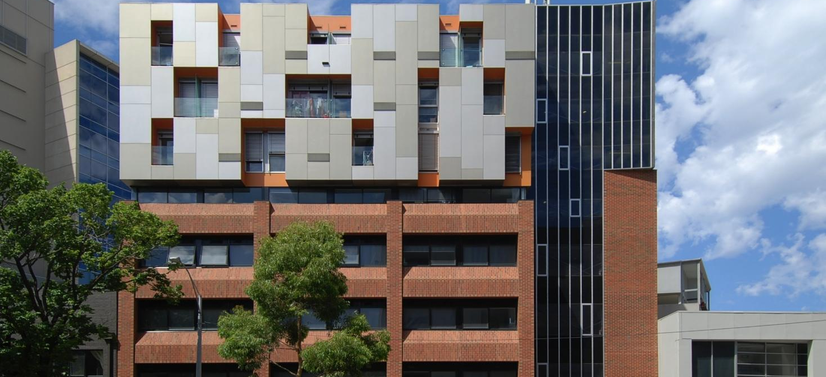
MELBOURNE
DEDICATED STUDENT HOUSING
Notes:
In parallel, private response :
A remarkable increase in student housing in central Melbourne = built to meet the new demands of this international student population
The appearance of large student housing buildings: dense, composed mainly of studios or micro-apartments
In addition = lack of common areas, very high rents = in central areas of the city.

Slide 11
MELBOURNE
AN EXCLUSIVE MARKET
VULNERABLE STUDENTS LOOKING
FOR HOUSING
STUDENT SEGREGATION
Notes:
Diagnosis:
Side effects of student concentration and lack of institutional planning = EMERGENCE OF A NEW MARKET, that is much more vulnerable: international student population
Treated as a separate market, distinct from the so-called "local" student population (which turns to apartments from the private rental market, in suburb areas, much lower rents)
Which leads to = residential separation between local student population and international student population
There is a Physical barrier with the rest of the student population
Increase of rents in central districts
Types of housing that go against socialization.

Slide 12
MELBOURNE
BETTER INTEGRATION
STUDENT HOUSING POLICY
STUDENT CO-OP PROJECT
Notes:
Call for Action:
Report published by the city and the University of Melbourne on the issues and needs of international students but also other students. Lead to government response in 2001 = Student Housing Policy : New construction and conversion with
better quality of life.
better Integration into city planning (public transport, proximity services, state of infrastructures, etc.)
=> 1 coop: Appearance of new coop initiatives like

Slide 13
MELBOURNE : BAREPORT CO-OP
Notes:
Check this slide with Laurent.
An example of coop initiative would be the Bareport coop = to answer to the problems of Melbourne: (42% of pop are students, 65% of international students feel lonely or isolated)
=> issues relating to student housing and la capacité du privé à en produire seul

Slide 14
MELBOURNE : BAREPORT CO-OP
AFFORDABLE HOUSING:
FACILITATES CROSS-CULTURAL
INTEGRATION
Notes:
Bareport → affordable, intercultural and community-focussed living
TRANSITION: conclusion → a private initiative to improve, which is also the case of Edinburgh on the private local market (not dedicated residences but still private initiatives)

Slide 15
EDINBURGH
CONFLICT WITHIN THE PRIVATE MARKET:
STUDENTS MAKE NOISE IN EDINBURGH
Notes:
Context:
-50% of residences are private
-0 public residences
-50% institutional residences
-20% are student housing cooperatives and other models
there is an increase in student population around universities → competition on the market
presence of landlord abuse → very vulnerable on local market
high concentration of housing leading to integration issues
There are a few coops and other initiatives. movement is really strong leading to the formation of lobby around the issues of student housing → social conflict

Slide 16
EDINBURGH
Notes:
Context:
Capital of Scotland
population of 511,852 people
Four big historical universities that have accompanied the development of the city and many other institutions of higher education (which are mainly located in the center of the city and the old town)
The university of edinburgh was one of the first english speaking universities in the world.

Slide 17
EDINBURGH
A GROWTH IN STUDENT
POPULATION
1 /6 PEOPLE ARE STUDENTS
Notes:
Student population has highly increased → more than 50% growth from the 90s to the mid 2000
Reaching a total of 70,000 students today, (about 1 person on 6) → 13.8%

Slide 18
EDINBURGH
DEDICATED STUDENT HOUSING
Notes:
However, 54% of this population will house in the private local market (housing)
There are dedicated housing offers but take in only 21% of the number of students

Slide 19
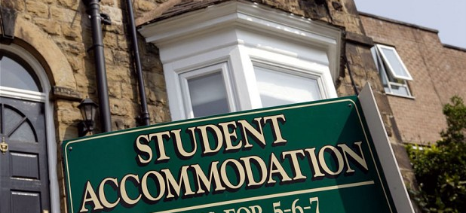
EDINBURGH
A CONCENTRATION IN THE
CENTRAL AREAS
HIGHER RENTS
COMPETITION FOR HOUSING
Notes:
Land pressure = Real lack of housing and push ⅓ of the population working in Edinburgh to live outside the city
In recent years: there is a 5% increase in rents
the present of student population in the private rental market is all the more noticeable. Especially that in these central sectors of the city, there is the development of a new offer of private student housing, which comes in the form of large residences (often buildings/ reinvested lands)
there is a search for large dwellings to live with roommates. However, having the capacity to pay higher rent creates a competition with other groups of the population (especially families)

Slide 20
EDINBURGH
STUDENT GHETTOS
CONFLICTS WITH NEARBY RESIDENTS
VULNERABLE STUDENTS IN THE
HOUSING MARKET
Notes:
Diagnosis:
FROM STUDENT NEIGHBORHOODS TO STUDENT GHETTOS:
The students win this competition
this results in the creation of neighborhoods that both the service offered and the population that resides there are entirely "students". = Organized around this population = Student monoculture, segregation / ghetto students
Citizen mobilization against new student housing projects attests to a strong feeling on the part of residents
+ Vulnerability of students in relation to the market: price + housing conditions (overflow, abuse by the owners, insalubrity)

Slide 21
EDINBURGH
PUBLIC POLICY
COOPERATIVE MOVEMENT
STUDENT CO-OP PROJECT
Notes:
Call for action: to answer these problems:
Section on student housing in city policy + guide with advices about the need to produce more dedicated student housing in order to release housing units for families.
limit the size of these new developments (140 rooms) and regulate their location (close to public transport or higher education institutions but most importantly in areas where the concentration of students does not exceed 30% in the future).
= Reflection that goes far on the form that these developments must take / to avoid overflow in the future and decrease problems observed to create balanced and mixed neighborhoods. Mixed because partly regulated - at the stage of intentions and recommendations
HOWEVER:
Student reaction to answer to this lack of housing, and especially to this vulnerability rising from this situation (relating to the landlord et so the price and quantity of housing) → development of the 1st cooperative student housing initiative in the UK:
→ objectives:
less vulnerable towards landlord
better integration in the urban environment
reflexion on the student presence/ impact on the local market/ its distribution/ its cohabitation with other groups of residents
Accessibility to studies (degrees)

Slide 22
SEOUL
Notes:
Seoul: Looking for new solutions: a public response
-0 of residences are private
-90%public residences
-10% institutional residences
-50% are student housing cooperatives and other models
housing student problems on the local market → public action
residences (large dormitory)
smaller houses
coops with some private initiatives

Slide 23
SEOUL
FIRST STUDENT CITY
OF THE COUNTRY
A LIMITED HOUSING MARKET
Notes:
Contexte:
Seoul population: 10, 2 million in 2012
Amazing economic development in a short time. Urbanization and transformation of Seoul.
But market that ignites (pressure), prevents part of the population from living in the city: rent too high. One of the most important social problems of the country.
⇒ Whereas it is the university city of the country + showcase on the world

Slide 24
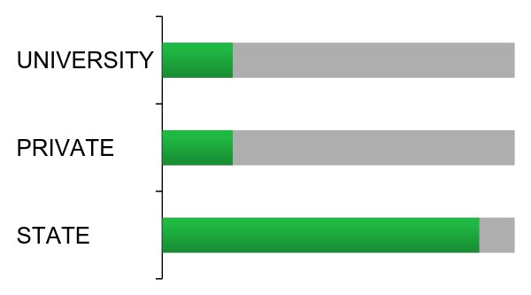
SEOUL
DEDICATED STUDENT HOUSING
Notes:
2012 = 450,000 students in Seoul. (4% = WEIRD)
11.6% of students in Seoul stay in dormitories planned by the university. This means that 80-90% of students from other provinces of Seoul have to find accommodation in one bedroom apartments / studios.
40% of students' monthly budget goes for housing (Bae Byeong-woo, a professor at the University of Seoul).
So ⇒ students turn to poor quality housing.
YMCA study that said that 83% lived alone (many housing units are divided to be rented to several individuals) and 52% live in less than 14 square meters.

Slide 25
SEOUL
MORE THAN 200 000 PUBLIC
HOUSING UNITS BUILT
60% FOR YOUNG AND STUDENTS
2 TYPES OF HOUSINGS
Notes:
Systems implemented: "lease program" by Korea Land and Housing Corporation. Students choose house and LH corporation rents it to the owner and then sublets it to the students.
But ESPECIALLY:
SO ⇒ Korea's Park Geun-hye administration: launches a project for more than 200,000 units of public rental housing. Project: "Happy housing" (aim to improve existing neighborhoods, increase and diversify housing offer, social mix,.) To support to initiatie 80 000 units built by the mayor of Seoul (Park Won-soon)
60% of these dwellings are designed for young professionals and students. Student housing construction around universities (provision of green spaces and services).
⇒ Spaces used = old railroad tracks + reservoirs (which served as green spaces in some neighborhoods) Forecast for 400,000 students (these developments + on campus).

Slide 26
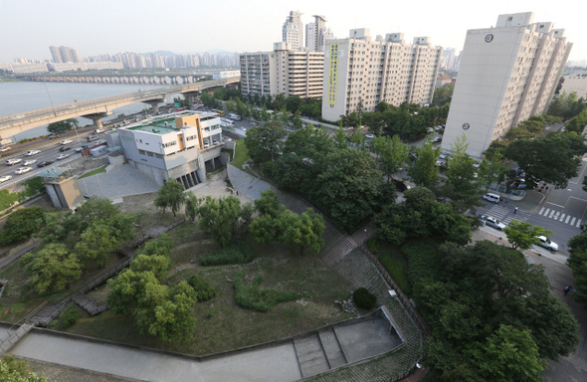
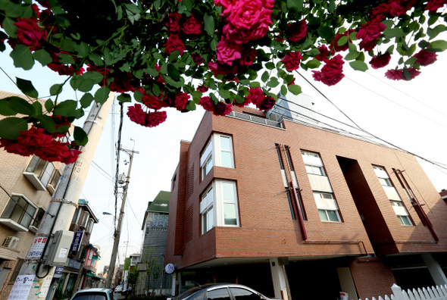
SEOUL
“HAPPY DORMITORY”
KWANGJIN DISTRICT
“HOPE DORMITORY”
MAPO DISTRICT
Notes:
Different type: "HAPPY DORMITORY" (large dormitories built) + "HOPE DORMITORY" (second = a house rented by the government that students rent and manage collectively: can renew and live there up to 4 years).
Two projects for example: (born from happy dormitory?)
-Kwangjin district: Old reservoir "transformed into student housing (20 floors, 700 units).
- Yeonnam neighborhood of Seoul's Mapo district: 5 floors, 29 units. Book-cafe.

Slide 27
SEOUL
MASSIVE PUBLIC RESPONSE
WHAT KIND OF STUDENT HOUSING ?
Notes:
Diagnosis:
Interesting that the public decides to react as massively. Always interesting when public builds.
Difference also for the type of housing, even if offer = public. In these two projects (both born under the hat of "Happy housing" + on land that belongs to the public = different insertion in neighborhoods:
First: poorly received
Second: meeting place, harmony, social mix and generation. Example. + Way to introduce the cooperative model / cooperative living.

Slide 28
SEOUL
RETHINKING STUDENT HOUSING
SUPPORT FROM THE PRIVATE MARKET
FERTILE GROUND FOR COOPS
Notes:
Action:
Pay attention to the form these developments take: both for the occupants/students and for the environment in which it is implemented. Forms of developments to prioritize, studies to conduct according to the contexts. Especially when one starts such development.
Opening / evolution: new market demand for "shared house". Reflection also from the private market: development WOOZOO house. 5th project by PJT Ok (social economy enterprise). Objective: to create a community that is a source of sharing, learning and interacting. Each house has a theme, last = creativity.
SO: MOMENT OR NEED HOUSING = DIFFERENT OPTIONS BUT NOTE THAT THE CONTEXT // SITUATION = fertile ground for coop.
Quote: "Society urges young people to receive tertiary education. But during education, we can not earn money to enter the market. Housing is a very urgent matter, and society must support its future generation. "Min Snail Union's Kwon

Slide 29
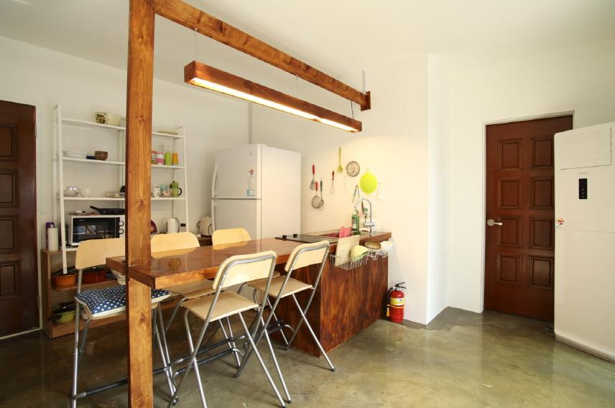
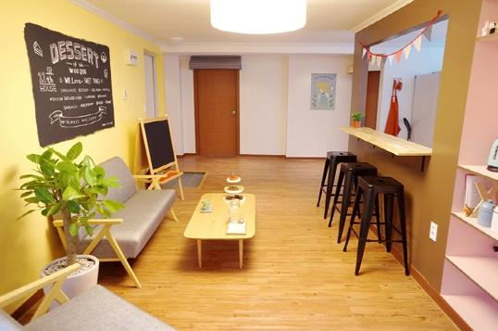
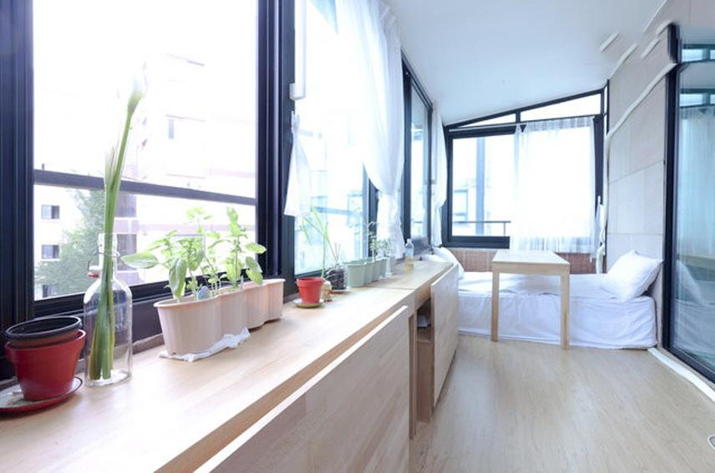
SEOUL : WOOZOO HOUSE
Notes:
4 personnes travaillent dessus. Pas résumable aujourd’hui!

Slide 30
GRENOBLE
THE PUBLIC ACTION IS OUT OF BREATH :
THE NEED FOR RENEWAL
Notes:
-0 of residences are private
-90%public residences
-10% institutional residences
-5% are student housing cooperatives and other models
public that provides with affordable housing → does not satisfy the demand → increase in prices → alternative solutions

Slide 31
GRENOBLE
Notes:
French city of 400,000 inhabitants
60,000 students (14% of the population)
A very attractive regional university center, more than half of the students come from the region

Slide 32
GRENOBLE
COMPETITION BETWEEN CITIES
HIGH RENTS ON THE MARKET
A LOSS IN STUDENT ENROLLMENT
Notes:
Context:
Between 2006 and 2009, however, the city experienced a drop in student numbers:
Indeed, the competition between university metropolises is intensifying and
the prices of the Grenoble rents are among the highest of the French university cities. (private market, expensive (73% of the - this represents on average 42% of their budget)

Slide 33
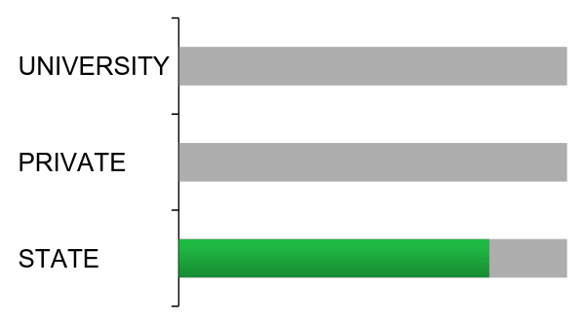
GRENOBLE
DEDICATED STUDENT HOUSING
Notes:
Background particular to france:
public residences managed by the CROUS “Centres régionaux des œuvres universitaires et scolaires” (Regional Centers for Academic Works). They are located near universities, they welcome 14% of students, but are degrading and form student ghettos. = a fairly common model at the European level (eg Studentenwerk)

Slide 34
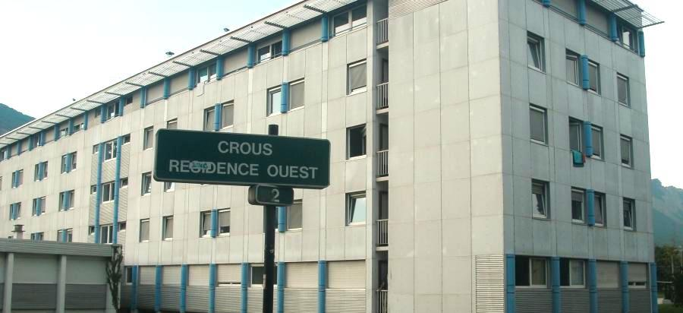
GRENOBLE
COMPETITION BETWEEN CITIES
HIGH RENTS ON THE MARKET
A LOSS IN STUDENT ENROLLMENT
Notes:
Typical rooms are 100 square feet, directly onto a corridor, with shared toilets and showers on the same floor. Aging buildings. Very not up-to-date design. Don’t you think it looks like a prison?

Slide 35
GRENOBLE
COMPETITION BETWEEN CITIES
HIGH RENTS ON THE MARKET
A LOSS IN STUDENT ENROLLMENT
STATE-OWNED HOUSING
CHEAP RENTS
OLD HOUSING STOCK
Notes:
The limited availability of affordable, public housing in the city, on top of the aging apartments that they offer mean that most students don’t want to live there. Not meeting the needs = they looked for collective alternatives.

Slide 36
GRENOBLE
LIMITED AFFORDABLE HOUSING
AN IMPERFECT PUBLIC OFFER
Notes:
DIagnosis:
expensive housing offer => drop in student enrollment = loss of qualified staff
supply of cheap public housing, but built up deteriorates, construction is insufficient to absorb the demand and the building is degraded and forms student ghettos = the CROUS fails to provide affordable housing for all

Slide 37
GRENOBLE
PUBLIC POLICY
COOPERATIVE MOVEMENT
KOT-À-PROJET (KAP)
Notes:
Action:
Agglomeration housing policy focused on land strategies
This policy notably supports alternative forms of housing production focused on non-speculation, social and generational diversity, pooling of services and sustainable management of buildings.
For example, the HABILE association is working on the emergence of cooperative habitat programs and the HABICOOP association offers, among other things, its legal assistance for the set-up of such projects. The idea is that reproducible legal and financial arrangements emerge in order to make these alternative forms of housing a complete production sector.
Grenoble is at the forefront of alternative housing forms in FR (where the model is very rare)
more Modernization of public action: Since 2010, new student housing have been created. "Kots à projet" or Kaps, sharing student housing formed around a common project with solidarity aim, are gaining popularity. Born 30 years ago on the territory, they invest in 2010 the residences of the CROUS and the housing of L'AFEV “Association de la Fondation Étudiante pour la Ville” (Association of the Student Foundation for the City). Built in 2012, these new solidarity-oriented student housing units are consciously located in the Mistral, a popular district of the city.

Slide 38
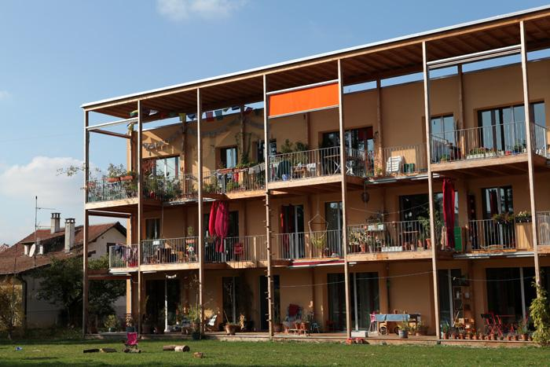
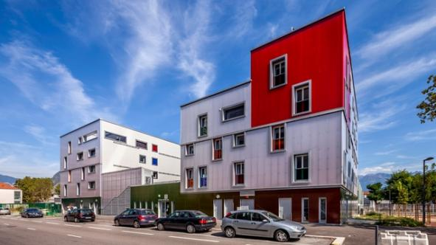
GRENOBLE
KAPS
REALISING
COLLECTIVE PROJETS
HABICOOP
COMING SOON FOR STUDENTS

Slide 39
GENEVA
THE CO-OP PARADISE

Slide 40
GENEVA
Notes:
Context:

Slide 41
GENEVA
ONE OF THE MOST EXPENSIVE
EUROPEAN CITIES
HOUSING CRISIS IN THE 1980s
Notes:
Context:
One of the most expensive cities in Europe
Housing crisis in the 80s
For regional equity (students do not come from Geneva, while this is where the important schools are) + accessibility to studies
→ Housing crisis = a big obstacle to that.
→ Vacancy rate in Geneva = 0.2% (find a comparison): so rent really expensive. To pay less: students go up to 10km from the canton or in France.
Testimony: "There is no comparison with other housing. Before, I lived in collocation with ten people, ten kilometers from the city center. And we paid rent twice as much, "says Simon

Slide 42
GENEVA
COOPERATIVE SOLUTION :
THE CIGÜE
FAVORABLE POLICY FRAMEWORK
FINANCIAL SUPPORT
Notes:
Reaction started with illegal squatting by the Cigüe and other groups in Switzerland
It became legal and they started having access to empty public buildings.

Slide 43
GENEVA
THE NEED FOR AFFORDABLE HOUSING
STUDENT MOBILISATION
PUBLIC SUPPORT
Notes:
The need was made publicly visible through the squatting campaign and student mobilisation
This led to public support, including granting city buildings and eventually, some public funding

Slide 44
GENEVA
NEW STUDENT HOUSING STOCK
SUPPORT FROM THE PUBLIC SECTOR
A SUSTAINABLE STUDENT
COOPERATIVE MOVEMENT
Notes:
Reaction of the Swiss State: Occupation in 1986 by a group against the crisis of the housing = the city grants a building to them and it is the beginning of a big coop
Supported by a donation of 10 million Swiss francs to finance this kind of project + law and regulations for construction of temporary student housing
Members paid rent for years even in buildings which were granted by the city = coop accumulated capital to build its own buildings (new! instead of semi-abandoned buildings)

Slide 45
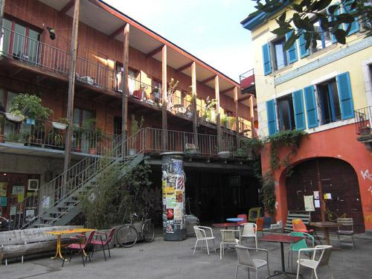
GENEVA : THE CIGÜE
MORE THAN 450 ROOMS
30 ADRESSES
“NO COMPARISON WITH OTHER HOUSING SOLUTIONS”
Notes:
today = more than thirty addresses and can house 450 students

Slide 46
MONTREAL
TOWARDS STUDENT CO-OPS :
A TURNING POINT FOR MONTREAL
Notes:
-50 %of residences are private
-1%public residences
-50% institutional residences
-UTILE% are student housing cooperatives and other models
Context:
private housing, expensive, which absorbs arriving often for 1 year, after they go on the rental market (but not integration to the district / town in the city)
non-existent public offer
institutional housing (do not meet the demand, fail to play this role, example of the scandal of the Island to the Traveler)

Slide 47
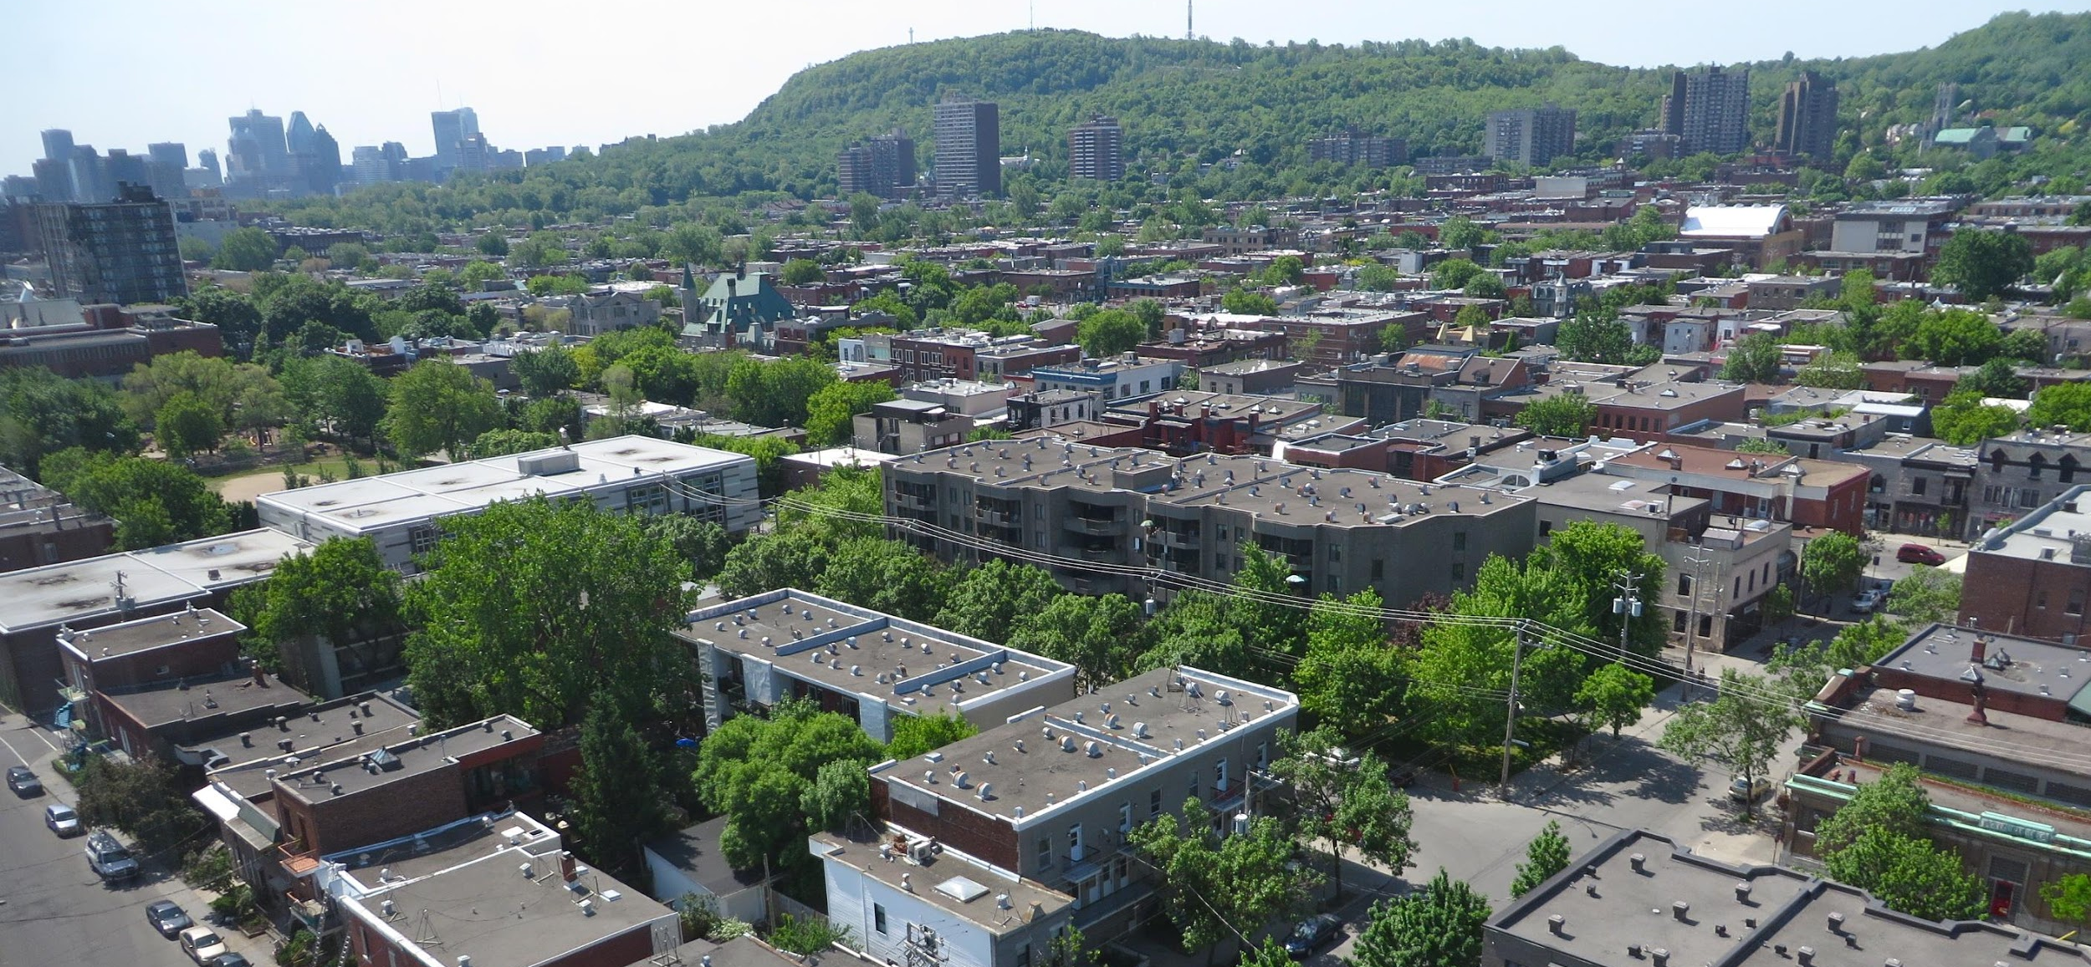
MONTREAL
Photo : Francely Rocher
Notes:
attractiveness at the inter and provincial levels → competition between provinces and other populations → Evo: private response → alternative response: UTILE (coops already well establised → model to extend to the students)

Slide 48
MONTREAL
ONE OF THE CHEAPEST
NORTH AMERICAN CITIES
A STUDENT MELTING POT
A CONCENTRATION IN THE
CENTRAL AREAS
Photo : Francely Rocher
Notes:
Agglomeration of 2M inhabitants
200,000 students (10%) of the population
ONE OF THE CHEAPEAST CITIES:
MELTING POT: QC LAND OF IMMIGRATION
Attractive metropolis:
MTL welcomes ¾ international students coming to QC
60% did not live in MTL before their study, 36% did not live in QC

Slide 49
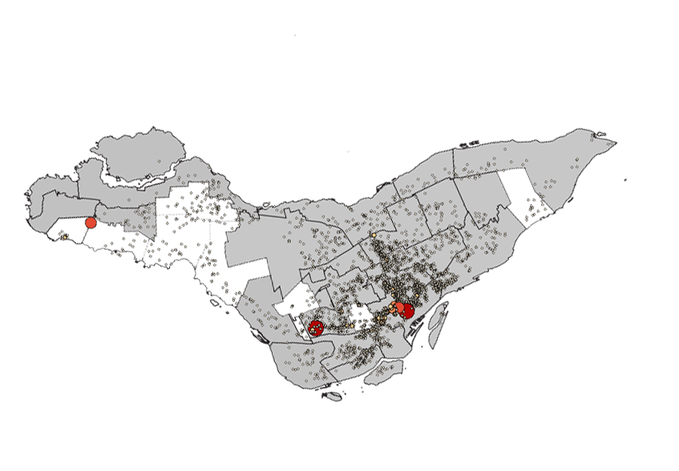
MONTREAL : STUDENT RENTERS
Source : UTILE’s study market

Slide 50
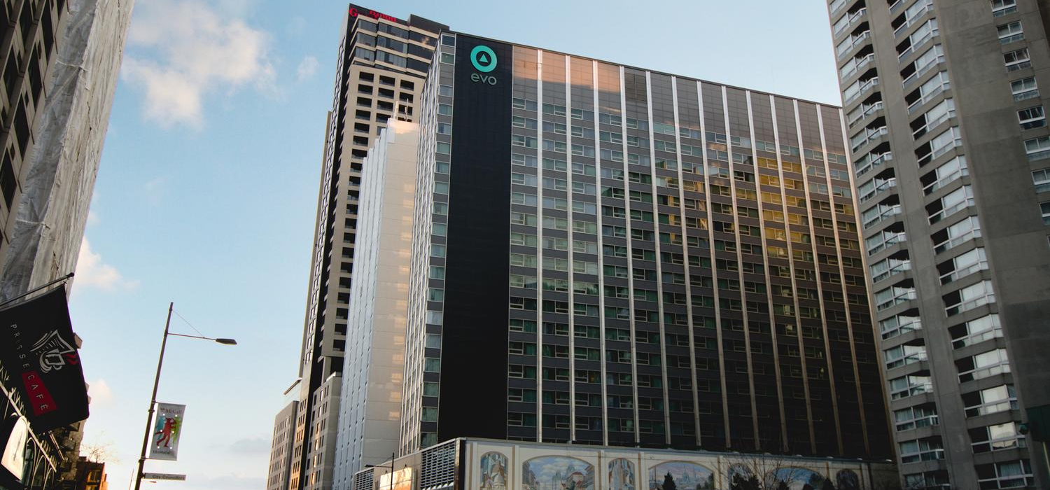
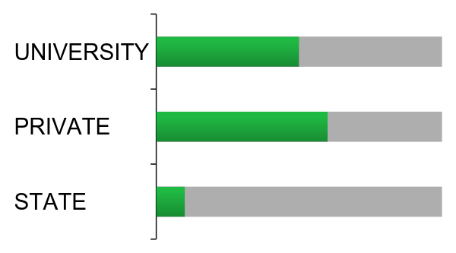
MONTREAL
DEDICATED STUDENT HOUSING
Source : UTILE’s study market
Notes:
International Attraction => private residence development + portrait (difference in rent: 849 medium / 930 median)
Private market: one of the most affordable of North AM, but pb
institutional Campus Offer (concordia, mcquill, udm, uqam)
Public offer: 0.6 in social housing-community

Slide 51
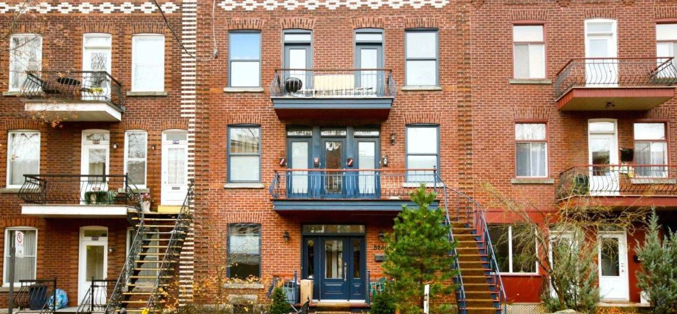
MONTREAL
50% ON THE HOUSING MARKET
2 TYPES OF COMPETITION
Source : UTILE’s study market
Notes:
MAJORITY IN THE PRIVATE MARKET, 50% of students rent an appartment
2 types of competition rises

Slide 52
MONTREAL
QUEBECER
VS
NON-QUEBECER STUDENTS
&
STUDENTS VS FAMILIES
Notes:
Attraction => competition with international students or other provinces and local students:
Arrival of students QC or not => competition with families (PHENOMENON THAT WE CAN SEE IN BOSTON AND GB)

Slide 53
MONTREAL
QUEBECER STUDENTS : 495 $
(FOR ONE ROOM, BILLS INCLUDED)
NON-QUEBECER STUDENTS : 605 $
Source : UTILE’s study market
Notes:
rent difference for local students and international students

Slide 54
MONTREAL
LIVING WITH ROOMATES
IN BIG APPARTEMENTS
ONE RENT PER ROOM
Source : UTILE’s study market
Notes:
the students live in the large shared housing
(80% IN RENT)
32% IN 3CC AND +
hypothesis: 1 income per room
obstacle: rent difference for 2cc, and even stronger for 3cc
Pb: the private market produces only small units

Slide 55
MONTREAL
PRESSURE ON THE CENTRAL AREAS
STUDENT GHETTOS
A CONTESTED PRIVATE MODEL
Notes:
Concentration of students in the central districts, long metro line (+ 20% of students in some neighborhoods)
Even if rent is low compared to Toronto or Vancouver => competition between population (E / E - E / F) especially in the central districts

Slide 56
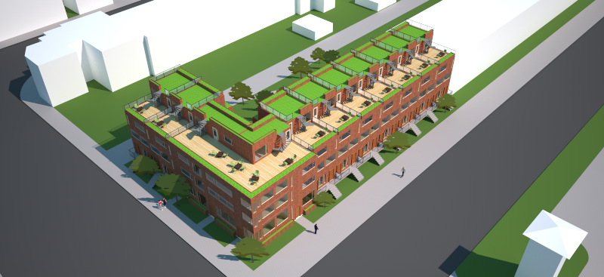
MONTREAL : UTILE’S CO-OP PROJECT
Models realised by Samuel Descôteaux Fréchette
Notes:
Call for Action: UTILE coop project

Slide 57
MONTREAL : UTILE’S CO-OP PROJECT
LONG-TERM AFFORDABILITY
QUALITY OF LIFE
A BETTER INTEGRATION
FREE HOUSING UNITS FOR FAMILIES
Models realised by Samuel Descôteaux Fréchette
Notes:
maintain long-term affordability
a model of life (is positioned in opposition to private residences)
deconcentrate pop, neighborhood integration
build large housing, collocation (shared rent) to unclog the market
propose alternative way of producing large housing (NPO)

Slide 58
CONCLUSION
CULTURAL LIVELINESS
ECONOMIC DYNAMISM
INTERNATIONAL OUTREACH
DEMOGRAPHIC RENEWAL
Notes:
Cities often want to attract students, but with that, often not taken into account, but problems arise. Often linked to affordability - because it is an additional pressure on the market.
Positive aspects:
Cultural dynamism
Economic dynamism (innovation, skilled labor)
International influence
Demographic renewal

Slide 59
CONCLUSION
CULTURAL LIVELINESS
ECONOMIC DYNAMISM
BRAIN DRAIN
INTERNATIONAL OUTREACH
DEMOGRAPHIC RENEWAL
PRICE INCREASE
STUDENT GHETTOS
COMPETITION BETWEEN STUDENTS
COMPETITION WITH FAMILIES
Notes:
Negative aspects:
Higher market prices,
Concentration
Student monoculture,
Competition with other groups including families and local students

Slide 60
CONCLUSION
A VERY PRIVATE RESPONSE IN MELBOURNE
CONFLICT WITHIN THE PRIVATE MARKET IN EDINBURGH
A PUBLIC RESPONSE IN SEOUL
THE PUBLIC ACTION IS OUT OF BREATH IN GRENOBLE
THE CO-OP PARADISE IN GENEVA
TOWARDS STUDENT CO-OPS IN MONTREAL
Notes:
=> highlighted student housing issues and the response that co-ops could provide in certain contexts

Slide 61
THANK YOU.
Presentation realised by: (Valentine About and Mathilde Rudloff) Kamden & Lynn with the precious help of Laurent Levesque
Notes:
EDIT SLIDE
=> end of the world tour, map with other places

